Slide 1
Designing studies
Chapters 1, 2

Slide 2
Learning objectives
Identify if a given data collection procedure is an observational study or randomized, comparative experiment
Define experimental unit, observational unit, treatment factor, etc.
Explain what pseudo-replication is
Explain purpose of randomization

Slide 3
Scientific method
Organized approach to avoid false starts and incomplete answers to research questions
Hypothesize mechanism for
what was observed
Observe state of nature
Collect data that will clearly
support/refute hypothesis
Update hypothesis
Reject?
Analyze data to confirm or reject
hypothesis

Slide 4
Experimentation Flow Diagram
Hypothesis → data collection phase: clearly state the objectives of experiment
Define Objectives
Choose Study Design
Data collection procedure
Model for Data Analysis
Analysis of Data and Interpretation of Results
Conclusions

Slide 5
Defining objectives
“What scientific questions hoping to answer?”
Data and analysis methodology to answer question?
Argue how the pairing can answer broad questions
What is the statistical objective?
Understand distribution of a single response?
Determine relationships between multiple variables?
Build a predictive model?
Determine causes of variation of a response?
Find conditions that optimize response?

Slide 6
Does Smoking Cause Lung Cancer? Study Design 1
Does frequent smoking of cigarettes cause lung cancer?
Study design idea: randomly sample many smokers and nonsmokers and compare the relative proportions of those with lung cancer
Analysis goal: determine whether smoking causes an increase in the probability of lung cancer
Is there an analysis that could give valid causal inferences?

Slide 7
Smoking Study Design 1: Two-Sample Proportion Test
Two-sample proportion test and find a statistically-significant difference between the proportions
Does this tell us smoking causes lung cancer?
If there is a causal effect, we expect difference
What else could explain the observed difference?
Random chance associated with Type I error
Any other thing that is related to or causes lung cancer such as genetics, work/home environment, age, etc.

Slide 8
Smoking Study Design 1: Regression Adjustment
Partition subjects based on extra variables and compare proportions within a group
Subjects in group influenced similarly by extra variables
Within-group differences more likely due to smoking alone
Issues:
Group sizes can vary and may be small for some cases
Accounted for every possible extra variable?
Works in theory but under a lot of assumptions
Upshot: need techniques to “adjust” for researcher’s lack of control over how subject becomes a smoker

Slide 9
Does Smoking Cause Lung Cancer? Study Design 2
What if we could assign subject to be smoker?
Yeah…you can’t do that
Let’s just pretend we can for now
Best way to assign subjects?
Limit possibility proportion differences occur due to known or unknown external variables
How to guard against variables we don’t know about?
RANDOM ASSIGMENT

Slide 10
Smoking Study Design 2: Random Assignment
Randomization reduces probability external variables are what cause differences
Guaranteed to remove effects for studies with many subjects
Still the gold standard for establishing causality
Different types of random assignments:
Completely randomized designs for unknown external variables
Block designs for some known external variables
Split plot designs for complicated assignments of treatments
“Block what you can, randomize what you can’t”

Slide 11
Observational Studies and Randomized, Controlled Expts
Study 1 is an observational study
Observe and record without controlled intervention
Only choose what and how you observe
Study 2 is randomized, comparative experiment
Controlled intervention where external variables held constant and others are purposefully changed
Observational studies aren’t bad, you just have to be careful about scientific conclusions made from data

Slide 12
Sources of variation Independent and treatment factors
Independent variable (or factor): variable thought to influence the dependent variable
Not in every observational study but is in every experiment
Values of a factor are called levels
Treatment factor: factor that experimenter intentionally varies
Unique to designed experiments
Dependent variable (or response): measured variable we think may be influenced by changes in independent variables

Slide 13
Types of external variables and relationships between variables
Nuisance factor: known variable that could influence response but not of particular interest
Sometimes fixed to specific level
Otherwise should be adjusted in the analysis
Lurking variables: like nuisance factor except it is unknown or unobservable
Randomization reduces chance treatment factor(s) are correlated with these types of variables
Two factors are confounded if perfectly correlated
E.g. every time assign subject to not smoke they must also exercise three times a week, smokers not allowed to exercise

Slide 14
Smoking Study Design 2: Applying Definitions
Independent variables (sources of variation):
Smoker/non-smoker
Genetic information
Age
Environment information
Dependent variable:
0/1 indicator for whether subject has lung cancer
Activity: identify the treatment factor and at least one nuisance and lurking factor

Slide 15
Treatment application process and experimental units
Treatment application process:
How is a treatment level applied?
How much control do you have over application?
What is it applied to?
Guarantee applications of same treatment are independent?
Experimental unit (EU): “subject” or “material” receiving an independent application of a treatment
How do you expect the treatment to affect the EU?
Observational unit (OU): part of the EU that measurements are taken on

Slide 16
Runs, Replicates, and Treatment application error
Run: the application of a treatment level to an EU and dependent variable measurement(s) from EU
# of EUs = # of runs
Yields one or more response measurements
Treatment replicate: Independent application of a treatment to a new EU
EU is potentially influenced by ALL steps involved in the treatment application process
Expect variation between replicates of same treatment (treatment application error)

Slide 17
Smoking Study Design 2: Applying Definitions
Activity: propose a treatment application process for a completely randomized, smoking study
Take multiple measurements from each person throughout the study period
500 people recruited in the study
Based on your description, what are EUs and OUs?
How many replicates would you recommend per treatment level?
Give hypothetical cause of treatment application error

Slide 18

Smoking Study Design 3
Randomly partition 50 mice into 10 chambers with 5 mice each
Randomly assign 5 of 10 chambers to receive smoke
Mice put in same chamber each day
Detect presence/absence of cancer in each mouse
What are the EUs and OUs in this experiment?

Slide 19
Pseudo-replication: confusing Ous with EUs
Every EU receives independent treatment application
OUs from EU receive same treatment application
Different from “receiving the same treatment”
Thinking of OUs as EUs is called pseudo-replication of a treatment
Assumes you have more information about treatments than you really do
Leads to larger Type I errors

Slide 20
Learning objectives Review
Identify if a given data collection procedure is an observational study or randomized, comparative experiment
Define experimental unit, observational unit, treatment factor, etc.
Explain what pseudo-replication is
Explain purpose of randomization

Slide 21
Planning Experiments
Chapters 1, 2

Slide 22
Learning objectives
Follow checklist for planning and conducting an experiment
Explain the purpose of each step in checklist
List the four principles of experimentation and their impact on the analysis of the design

Slide 23
Planning Checklist
Define objectives
Define meaningful and measurable response
Diagram treatment application process for a single run
Identify experimental units
List sources of variation
Perform pilot runs
Choose experimental design (i.e. randomization)
Determine number of replicates required
Describe method(s) for data analysis
Timetable and budget for resources to complete experiment
Answers to one step may make you revisit previous steps

Slide 24
Defining objectives
“What questions are you hoping to answer?”
Broader than the data-specific questions
What pairing of data and analysis methodology can answer this question?
Argue how the pairing can answer broad questions
What will your analysis focus on?
Understand distribution of a single response?
Determine relationships between multiple variables?
Build a predictive model?
Determine causes of variation of a response?
Find conditions that optimize response?

Slide 25
Defining Meaningful Response
Characteristic of the EUs can be reliably measured and recorded after each run
Represent changes caused by treatment application
Determine how large an effect should be for treatment differences to be practically meaningful
Single measurement or repeated measurements?
Measurement variability?

Slide 26
diagram Treatment application process
List out thorough explanation about how a treatment will be applied for a given run
Leads to repeatable and reproducible experimental protocol
Anticipate potential difficulties or inconsistencies
Helps determine the EUs, but may not completely answer the question

Slide 27
Identify Experimental units
What exactly are you applying each treatment factor level to?
Some possibilities
Animal
Human subject
Raw material for some processing operation
Conditions that exist at a point in time (most abstract)
May have multiple descriptions, pick the one that is mostly influenced by the treatment factors

Slide 28
List Sources of Variation
Consider variables that are known to or may significantly influence the response
Response is measured from OUs taken from EUs
Which variables affect EUs? Influence response?
How are we measuring response? Reliable?
Specify as quantitative or categorical
Highlight the treatment factor(s)
Variables that are influential but uncontrollable are lurking variables (can these be measured?)
Are variables held constant? What level and why?

Slide 29
Perform pilot runs
Try out the experimental protocol on a few EUs
Verify or determine the following:
Can control and vary factors selected
Response can be reliably measured
Treatment application process is repeatable
Rough estimate of variation
May need to revisit previous steps after this part
Not always possible but always beneficial when done

Slide 30
Choose experimental design
Consistent with objectives and prevents uncontrollable changes in lurking variables from biasing effects
Specifically states which treatment factor levels will be studied and how they are assigned to EUs
This course surveys many designs depending on objectives and identified nuisance factors
Each design has a proscribed randomization method of assigning treatment conditions to EUs

Slide 31
Determine number of replicates required
How many replicates for each treatment condition?
Requires an expected variance and effect size of a practical difference
Aims to give researcher a high probability of detecting the desired effect size
Based on statistical model and analysis procedure

Slide 32
Describe methods of analysis
Write statistical model and clearly explain what each parameter represents
One-way ANOVA
Multi-way ANOVA
Regression models
General linear model (both ANOVA and regression)
Inference methods: hypothesis testing? Confidence intervals? Post-hoc analysis?
Reference how these answer stated objectives
Anticipate difficulties and back-up analyses

Slide 33
Time Table and Budget
Experiments take time and have a lot of moving parts
Having a schedule keeps the experiment moving forward and improves the chances of the research being completed on time
Outline budget for expenses and resources available
Make sure the proposed design is in line with the budget, otherwise revisit the design

Slide 34
Paper Airplane experiment
Two competing paper airplane designs and you want to determine which design is best
Recruit human subjects to build and throw airplanes
Define objectives
Define meaningful and measurable response
Diagram treatment application process
Identify experimental units
List sources of variation

Slide 35
Key principles of design
An experimental design specifies the assignment and application of treatments to a set of EUs
A “good” experimental design will reduce bias and minimize variance of the truth we want to estimate
The following four principles are basic requirements for a successful experiment
Representativeness
Replication of treatments
Randomization
Local error control

Slide 36
representativeness
Applies to all studies, not just experiments
EUs should be representative of the population we want to make inferences from
Mouse smoking experiment: extend results to humans?
Reducing EU-to-EU variability reduces experimental error, but at the cost of representativeness
Design techniques exist that broaden pool of EU’s without increasing response variation

Slide 37
Replication
In order to be certain of a treatment’s effect, it must be observed repeatedly with independent applications across different EUs
Increasing replication can lead to
Better estimate of variation
Increased precision of treatment comparisons
Assurance against aberrant results due to random chance
Increase in cost
Replication does not decrease variation!
Including more EUs, which are less likely to be similar

Slide 38
randomization
Given fixed number of replications for each treatment, determine allowable assignments of treatments to EUs (depends on design)
A design has been properly randomized when all allowable assignments are equally likely to be used
Haphazard assignment does not equal proper randomization!
Not enough to say that each treatment has the same chance of being assigned to any EU

Slide 39
randomization
Foundation for causal inference, since we can actively reduce the possibility of bias
Randomization also generates its own statistical analysis with minimal assumptions
You will be asked to describe the randomization procedure for every design we learn about
I will grade the procedure as if I know little about statistics and am following your instructions

Slide 40
Local Error control
Techniques to minimize variation
“Local” because it is specific to the one experiment
Some examples
Controlling the experiment environment (done in labs)
Choosing experimental units to be as similar as possible
Minimize treatment replication error
Red-highlighted techniques above could sacrifice representativeness
Employ design techniques to reduce variation without sacrificing representativeness

Slide 41
Local Error control Blocking
Consider EUs and identify nuisance factors that could influence response
Inherent property of EUs (e.g. sex, weight, manufacturer)
Environmental influences (e.g. operator, wind, time)
Block: group of EUs with similar nuisance levels
Each block should receive all possible treatments when possible
Smoking study design 2
Comparing treatments within each block and “pooling” results reduces experimental error

Slide 42
Local Error control ANAlysis of Covariance
Can only block if we know about nuisance factors prior to randomization
What to do if we can only measure nuisance immediately before treatment application?
Propose statistical model to “adjust” for covarying effects of the nuisance factors on response
Block designs require specific statistical models, too, but are different because they have their own randomization scheme
Success depends on accuracy of statistical model

Slide 43
Ethical considerations
Obviously, ethical considerations need to be considered when designing an experiment
If experimenting on living beings you need to first get Internal Review Board (IRB) approval
Clever experimental designs can maximize information using minimal resources and reduce impact on environment and animals
Ethical considerations/constraints can often lead to interesting design problems
Crossover designs
Clinical trials

Slide 44
Learning objectives Review
Follow checklist for planning and conducting an experiment
Explain the purpose of each step in checklist
List the four principles of experimentation and their impact on the analysis of the design

Slide 45
One-Factor Analysis Models and estimators
Chapter 3-5, 8

Slide 46
Learning objectives
Explain conditional distribution
Write cell-means, effects, and polynomial regression models
Identify which model is appropriate by identifying type of factor
Derive expected value and standard error of a linear estimator
Define estimability

Slide 47
Notation indices and variables
Single factor under study that has t unique levels
Index levels by $i=1,…t$
Observe $r_{i}≥1$ responses for level i
Allow $r_{i}$ to depend on i, so may not be equal # observations
Index responses for given i by $j=1,…,r_{i}$
If $r_{i}=1$ for all i
$y_{ij}$: represents j-th response under factor level i
A realization of the random variable, $Y_{ij}$
$x_{ij}$ : factor level for $y_{ij}$ ($x_{i1}=x_{i2}=…=x_{ir_{i}}$)

Slide 48
Notation indices and variables
Used for both observational studies and designed experiments
Smoking study design has factor with t=2
$x_{1j}=$ “Smoking”
$x_{2j}=$ “Non-Smoking”
If equal # of subjects in two groups, $r_{1}=r_{2}=r$
Ignore smoking factor and consider Age as a factor?
Probably many unique values (large t)
$r_{i}=1$ for many i (many 18 year olds but few 77 year olds)

Slide 49
Categorical and Numeric Variables
Categorical factor: takes on a finite number of values that may or may not be ordered
Ordinal → values have natural ordering but differencing the values doesn’t make sense (think rankings)
Nominal → no obvious order
Numeric factor: discrete or continuous but values can be ordered and differences make sense
Count data
Temperature
Age
Type of factor influences your analysis!

Slide 50
Conditional Distributions
Distribution of $Y_{ij}$ dictates how the $y_{ij}$ are generated
Analysis goal: does the $Y_{ij}$ distribution change if the factor levels change?
Asking about the conditional distribution of $Y_{ij}$ given/conditioned on $x_{ij}$
If conditional distributions all the same, then no relationship between $Y_{ij}$ and $x_{ij}$

Slide 51
Conditional Distributions Expected Value
Lots of ways the conditional distribution can change
Mean (i.e. Expected value)
Variance
Skewness
Quantiles
Etc.
Focus solely on changes in expected value
Represent this dependence mathematically as
$$E\left(Y_{ij}\right)=μ_{i} Var\left(Y_{ij}\right)=σ^{2}$$

Slide 52
Practice Soap Experiment
Factor with 3 levels: Regular, Deodorant, Moisturizing
Relabel as 1, 2, 3
Response is weight loss (g)
4 cubes per soap type, 1 measurement each
Identify values i and j can take
List out all possible $Y_{ij}$
Draw pictures of distributions assuming normality:
$μ_{1}=0, μ_{2}=2.5, μ_{3}=2$
$σ=0.25$

Slide 53
Cell-means Model Categorical Factors
Cell-means model has different mean for each i
$Y_{ij}$ depends on $x_{ij}$ through $μ_{i}$
Randomness of response comes from error $E_{ij}$ having mean 0 and variance $σ^{2}$
Assume $E_{ij}$ are independent and normally distributed
Analysis goal: are the $μ_{i}$ equal or different?
If at least one $μ_{i}$ is different from rest then the conditional distribution changes
$$Y_{ij}=μ_{i}+E_{ij}$$

Slide 54
Cell-means and Effects Model Categorical Factors
Cell-means model doesn’t clearly state the effect of the treatment, only that means are different
Rewrite $μ_{i}=μ+τ_{i}$
$μ$ : overall, constant effect on expected value
$τ_{i}$ : effect specific to $x_{ij}$ (really just i)
Entire effects model is written as
iid = independent, identically distributed
$$i=1,…,t$$
$$j=1…,r_{i}$$
$$E_{ij}∼^{iid}N(0,σ^{2})$$
$$Y_{ij}=μ+τ_{i}+E_{ij}$$

Slide 55
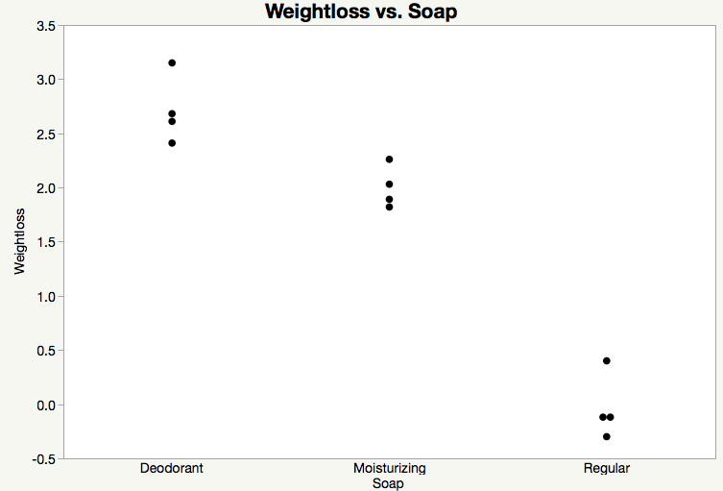
Visualizing Models Cell means
Recall soap experiment:
$x_{ij}=$ “Regular”, “Deodorant”, “Moisturizing”
$Y_{ij}=$ weight loss (in grams)
$$E\left(Y_{ij}\right)=μ=1.5?$$
Probably not. We expect
points to be fairly symmetric
about their expected value

Slide 56
Visualizing Models Cell means
Recall soap experiment:
$x_{ij}=$ “Regular”, “Deodorant”, “Moisturizing”
$Y_{ij}=$ weight loss (in grams)
$$μ_{1}= 2.70$$
$$μ_{2}= 1.99$$
$$μ_{3}=−0.04$$
Looks pretty good!

Slide 57
Visualizing Models Effects Model
Recall soap experiment:
$x_{ij}=$ “Regular”, “Deodorant”, “Moisturizing”
$Y_{ij}=$ weight loss (in grams)
$$μ = 1.50$$
$$τ_{1}= 1.20$$
$$τ_{2}= 0.49$$
$$τ_{3}=−1.54$$
$$μ_{1}= 2.70$$
$$μ_{2}= 1.99$$
$$μ_{3}=−0.04$$
Same as before!

Slide 58
Visualizing Models Effects Model
Recall soap experiment:
$x_{ij}=$ “Regular”, “Deodorant”, “Moisturizing”
$Y_{ij}=$ weight loss (in grams)
$$μ = 0.00$$
$$τ_{1}= 2.70$$
$$τ_{2}= 1.99$$
$$τ_{3}=−0.04$$
$$μ_{1}= 2.70$$
$$μ_{2}= 1.99$$
$$μ_{3}=−0.04$$
Wait….same as before?

Slide 59
Overparameterized Models
Cell-means model has t unique $x_{ij}$’s and t $μ_{i}$
Effects model has t unique $x_{ij}$’s but t+1 parameters
Say it is overparameterized
To make the model parameters uniquely identifiable, you must impose side conditions such as
$$μ=0 τ_{t}=0 \sum_{i}{τ_{i}=0 \sum_{i}{r_{i}τ_{i}}=0}$$
Avoid this and talk about estimability later on

Slide 60
Simple Linear regression model Numeric Factors
If $x_{ij}$ is numeric then can use the cell-means or effects model but not recommended
Reason: t is usually large and $r_{i}=1$ so there are many parameters that we need to estimate
Simple linear regression proposes a simple relationship using only two parameters
$$μ_{i}=β_{0}+β_{1}x_{ij}$$
Again assume $x_{i1}=x_{i2}=…=x_{ir_{i}}$
Mean increases/decreases linearly as $x_{ij}$ increases

Slide 61
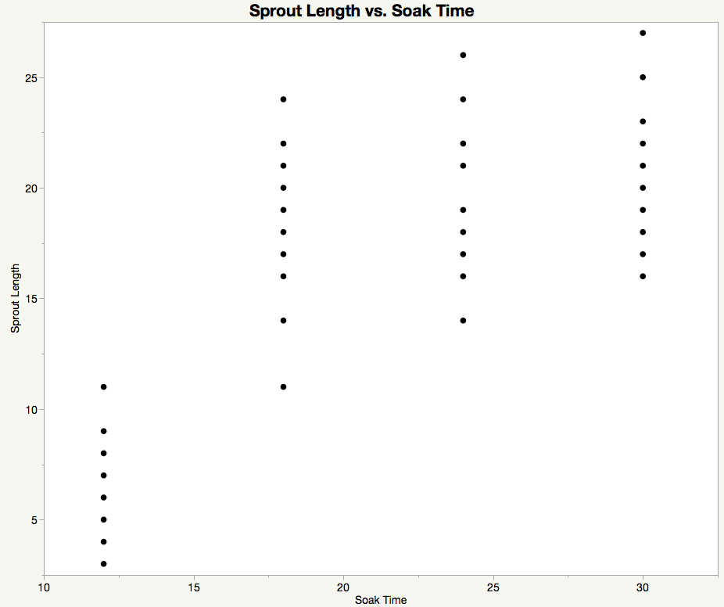
Visualizing Models Cell means for numeric
Bean-soaking experiment: packaging says to soak mung bean seed sprouts overnight but no specific time is given
$x_{ij}=$ 12, 18, 24, 30 hours
$Y_{ij}=$ sprout length (mm) after 48 hours $r_{i}=17$
Cell-means model could be
$$μ_{1}= 5.94$$
$$μ_{2}= 18.41$$
$$μ_{3}= 19.53$$
$$μ_{4}= 21.29$$

Slide 62
Visualizing Models Simple linear regression
Bean-soaking experiment: packaging says to soak mung bean seed sprouts overnight but no specific time is given
$x_{ij}=$ 12, 18, 24, 30 hours
$Y_{ij}=$ sprout length (mm) after 48 hours $r_{i}=17$
Regression model could be
$$μ_{i}=β_{0}+β_{1}x_{ij}$$
$$β_{0}=0 β_{1}=1$$
Probably not. Poor mean
for $x_{i}=30$

Slide 63
Visualizing Models Simple Linear regression
Bean-soaking experiment: packaging says to soak mung bean seed sprouts overnight but no specific time is given
$x_{ij}=$ 12, 18, 24, 30 hours
$Y_{ij}=$ sprout length (mm) after 48 hours $r_{i}=17$
Regression model could be
$$μ_{i}=β_{0}+β_{1}x_{ij}$$
$$β_{0}=−0.217 β_{1}=0.786$$
Looks better, but is still poor

Slide 64
Polynomial regression model
A linear relationship may be too simplistic
The quadratic regression model allows for curvature
$$μ_{i}=β_{0}+β_{1}x_{ij}+β_{2}x_{ij}^{2}$$
A polynomial regression model is of the form
$$μ_{i}=β_{0}+β_{1}x_{ij}+β_{2}x_{ij}^{2}+…+β_{p}x_{ij}^{p}$$
These are still linear models because we never take any nonlinear functions of the parameters

Slide 65
Visualizing Models Quadratic regression
Bean-soaking experiment: packaging says to soak mung bean seed sprouts overnight but no specific time is given
$x_{ij}=$ 12, 18, 24, 30 hours
$Y_{ij}=$ sprout length (mm) after 48 hours $r_{i}=17$
Regression model could be
$$μ_{i}=β_{0}+β_{1}x_{ij}+β_{2}x_{ij}^{2}$$
$$β_{0}=−29.66 β_{1}=3.91$$
$$β_{2}=−0.07$$
Better than linear!

Slide 66
Cell-means versus Polynomials Numeric factors
Cell-mean models
Capture complicated relationships but require many parameters
Can’t predict for unobserved factor values
Polynomial models
Approximate relationships fairly well with fewer parameters
Can predict for unobserved factor values
Do not extrapolate predictions outside of the observed values!
What do we do after we decide on a model?

Slide 67
Statistical Inference
Statistical models involve unknown parameters
Use observed data to infer what the parameters are
An estimator of a parameter is a function of the data that informs us about the parameter
Where do these estimators come from?
How to compare competing estimators?

Slide 68
Mean Squared Error
Let ${\hat{μ}}_{i}$ denote some estimator for $μ_{i}$
$MSE\left({\hat{μ}}_{i}\right)=E{\left[\left({\hat{μ}}_{i}−μ_{i}\right.\right)}^{2}]$
Want this difference to be as small as possible
Has the following decomposition
If $E\left({\hat{μ}}_{i}\right)=μ_{i}$ then $Bias\left({\hat{μ}}_{i}\right)=0$
Call ${\hat{μ}}_{i}$ an unbiased estimator
$$MSE\left({\hat{μ}}_{i}\right)=Var\left({\hat{μ}}_{i}\right)+Bias{\left({\hat{μ}}_{i}\right)}^{2}$$
$$Bias\left({\hat{μ}}_{i}\right)=E({\hat{μ}}_{i}−μ_{i})$$

Slide 69
Parameter Estimation using Least-squares
Least-squares (LS) estimators minimize
$$\sum_{i}{\sum_{j}{{\left(Y_{ij}−{\hat{μ}}_{i}\right)}^{2}}}$$
Fact: LS estimators can be represented by
$$\sum_{i}{\sum_{j}{h_{ij}Y_{ij}}}$$
Estimators of this form are called linear estimators
Linear combination of $Y_{ij}$

Slide 70
Statistical properties of linear estimators
Expected value always distribute over sums
$$E\left(\sum_{i}{\sum_{j}{h_{ij}Y_{ij}}}\right)=\sum_{i}{\sum_{j}{E(h_{ij}Y_{ij})}}$$
Distribute over constants (non-random)
$$\sum_{i}{\sum_{j}{E(h_{ij}Y_{ij})}}=\sum_{i}{\sum_{j}{h_{ij}E\left(Y_{ij}\right)=}}\sum_{i}{\sum_{j}{h_{ij}μ_{i}}}$$
Since $μ_{i}$ doesn’t have a j subscript we can simplify to
$$\sum_{i}{\sum_{j}{h_{ij}μ_{i}=\sum_{i}{h_{i}. μ_{i}}}} h_{i}.=\sum_{j}{h_{ij}}$$
Result: linear estimator is unbiased for some linear combination of $μ_{i}$

Slide 71
Statistical properties of linear estimators
A linear combination, $\sum_{i}{c_{i}μ_{i}}$, is estimable if there exists a linear, unbiased estimator:
From before we must have $h_{i}.=c_{i}$
Extract the $c_{i}$ from given expression
$μ_{1}$ has $c_{1}=1$ and $c_{2}=…=c_{t}=0$
$μ_{1}−μ_{2}=μ_{1}+(−μ_{2})$ has $c_{1}=1, c_{2}=−1, c_{3}=…c_{t}=0$
A contrast is a $\sum_{i}{c_{i}μ_{i}}$ where $\sum_{i}{c_{i}=0}$
$$E\left(\sum_{i}{\sum_{j}{h_{ij}Y_{ij}}}\right)=\sum_{i}{c_{i}μ_{i}}$$

Slide 72
Least-squares Estimators Cell-means Model
For cell-means model we have
$${\hat{μ}}_{i}=\sum_{j}{\frac{1}{r_{i}}Y_{ij}=\frac{1}{r_{i}}\sum_{j}{Y_{ij}=\frac{1}{r_{i}}Y_{i}.={\overline{Y}}_{i}.}}$$
Average of the responses for value i
$E\left({\overline{Y}}_{i}.\right)=μ_{i} Var\left({\overline{Y}}_{i}.\right)=σ^{2}/r_{i}$
Design impact: if you increase $r_{i}$ you decrease variance of your estimator

Slide 73
Least-squares Estimators Simple Linear Regression
For simple linear regression
$${\hat{β}}_{0}=\overline{Y}..−{\hat{β}}_{1}\overline{x}. . {\hat{β}}_{1}=\frac{\sum_{i}{\sum_{j}{(x_{ij}−\overline{x}..)(Y_{ij}−\overline{Y}..)}}}{\sum_{i}{\sum_{j}{{\left(x_{ij}−\overline{x}..\right)}^{2}}}}$$
$E\left({\hat{β}}_{0}\right)=β_{0} Var\left({\hat{β}}_{0}\right)=σ^{2}\left(\frac{1}{n}+\frac{\overline{x}{..}^{2}}{\sum_{i}{\sum_{j}{{\left(x_{ij}−\overline{x}..\right)}^{2}}}}\right)$
$E\left({\hat{β}}_{1}\right)=β_{1} Var\left({\hat{β}}_{1}\right)=\frac{σ^{2}}{\sum_{i}{\sum_{j}{{\left(x_{ij}−\overline{x}..\right)}^{2}}}}$
$n=\sum_{i}{r_{i}}$ is the total number of observations
Design impact: if you increase $\sum_{i}{\sum_{j}{{\left(x_{ij}−\overline{x}..\right)}^{2}}}$ the variance decreases for BOTH parameters

Slide 74
Least-squares Estimators Effects Model
Remember that identifiability issue? Tells us that the individual parameters may not be estimable
Every estimable function of the form
$$\sum_{i}{c_{i}μ_{i}=\sum_{i}{c_{i}\left(μ+τ_{i}\right)=μ\sum_{i}{c_{i}+\sum_{i}{c_{i}τ_{i}}}}}$$
For $μ$ to be estimable by itself we need to pick $c_{i}$ so that $\sum_{i}{c_{i}τ_{i}=0}$ for every possible $τ_{i}$ (does not exist)
Can’t estimate individual $τ_{i}$ either
What functions are estimable?
$μ_{i}=μ+τ_{i}$
Contrasts:$\sum_{i}{c_{i}τ_{i}}$ where $\sum_{i}{c_{i}=0}$ (e.g. $τ_{i}−τ_{i′}$)

Slide 75
Least-squares Estimators Effects Model
Even though parameters aren’t estimable we still have least-squares estimators for them
An infinite number of them and none of them are unbiased
Different software give different estimators
Still use these estimators for estimable functions
Say we have estimators $\hat{μ}$ and ${\hat{τ}}_{i}$
Least-squares estimators for estimable functions are then
$\hat{\sum_{i}{c_{i}τ_{i}}=}\sum_{i}{c_{i}{\hat{τ}}_{i}}$ and $\hat{μ+τ_{i}}=\hat{μ}+{\hat{τ}}_{i}$
Important: estimable function estimator same regardless of the chosen $\hat{μ}$ and ${\hat{τ}}_{i}$

Slide 76
Least-squares Estimators Effects Model
Simplifications for this model, but not generally
$\sum_{i}{c_{i}{\hat{τ}}_{i}}=\sum_{i}{c_{i}{\overline{Y}}_{i}.}$ $Var\left(\sum_{i}{c_{i}{\overline{Y}}_{i}.}\right)=σ^{2}\sum_{i}{\frac{c_{i}^{2}}{r_{i}}}$
$\hat{μ}+{\hat{τ}}_{i}={\overline{Y}}_{i}.$ $Var\left({\overline{Y}}_{i}.\right)=\frac{σ^{2}}{r_{i}}$
Design impact: increasing $r_{i}$ for all treatments in a given contrast decreases variance of that contrast
If equally interested in all contrasts then maximize $r_{i}$
Why equal replication is recommended!

Slide 77
Learning objectives Review
Explain a conditional distribution
Write cell-means, effects, and polynomial regression models
Identify when which model is appropriate by identifying type of factor
Derive expected value and standard error of a linear estimator
Define estimability

Slide 78
Appendix: More on Notation
Subscripts $i=1,…,t$ and $j=1,…,r_{i}$ are necessary tools for framework that applies to many analyses
Linear combinations involve real numbers $h_{ij}$ indexed by i and j in table
Think of arranging these numbers in a table
Example: $i=1,..,3$ with $r_{1}=5, r_{2}=3, r_{4}=9$
j
 | 1 | 2 | 3 | 4 | 5 | 6 | 7 | 8 | 9
1 | $$h_{11}$$ | $$h_{12}$$ | $$h_{13}$$ | $$h_{14}$$ | $$h_{15}$$
2 | $$h_{21}$$ | $$h_{22}$$ | $$h_{23}$$
3 | $$h_{31}$$ | $$h_{32}$$ | $$h_{33}$$ | $$h_{34}$$ | $$h_{35}$$ | $$h_{36}$$ | $$h_{37}$$ | $$h_{38}$$ | $$h_{39}$$
i

Slide 79
Appendix: More on Notation
The sums for each row are denoted by $\sum_{j}{h_{ij}=h_{i}.}$
Previous example:
$h_{1}.=h_{11}+h_{12}+h_{13}+h_{14}+h_{15}$
$h_{2}.=h_{21}+h_{22}+h_{23}$
The sums for each column are denoted by $\sum_{i}{h_{ij}={h.}_{j}}$
Previous example:
${h.}_{1}=h_{11}+h_{21}+h_{31}$
$h_{4}.=h_{14}+h_{34}$ (why is $h_{24}$ missing from here?)
The overall sum is $\sum_{i}{\sum_{j}{h_{ij}}=h..}$

Slide 80
Appendix: More on Notation
The overall sum can be expressed in two other ways
$h.. =\sum_{i}{h_{i}.}$
$h..=\sum_{j}{h._{j}}$
Practice notation with the following table
j
 | 1 | 2 | 3 | 4 | 5 | 6 | 7 | 8 | 9
1 | $$1$$ | $$1$$ | $$2$$ | $$2$$ | $$10$$
2 | $$0.5$$ | $$−0.5$$ | $$0$$
3 | $$1$$ | $$2$$ | $$3$$ | $$4$$ | $$5$$ | $$6$$ | $$7$$ | $$8$$ | $$9$$
i
$$h_{1}.=16 h._{2}=2.5 h._{9}=9 h..=16+0+45=61$$

Slide 81
One-Factor Analysis: Part 2
Chapter 3-5, 8

Slide 82
Learning objectives
Define a sampling distribution for a statistic
Write null and alternative hypotheses for two-sample tests and simple linear regression
Understand relationship between null and alternative distributions
Explain how to calculate Type 1 error and power

Slide 83
Bread yeast and time to rise
Yeast is added to bread to make it “rise”
Contacts warm water and feeds on sugars in the flour
Releases carbon dioxide at some rate
Bread dough rests for a period of time to allow this process to happen
Compare two different rise times to see if there is a significant difference in dough height
35 and 45 minutes (quantitative or categorical?)
Large batch of dough partitioned into N loaf pans

Slide 84
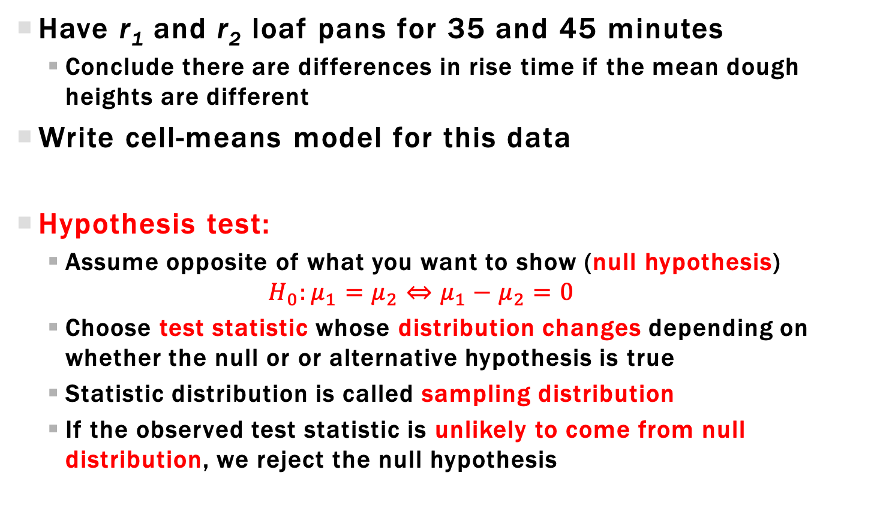
Two Sample Hypothesis testing
Have r₁ and r₂ loaf pans for 35 and 45 minutes
Conclude there are differences in rise time if the mean dough heights are different
Write cell-means model for this data
Hypothesis test:
Assume opposite of what you want to show (null hypothesis)
$$H_{0}:μ_{1}=μ_{2}⇔μ_{1}−μ_{2}=0$$
Choose test statistic whose distribution changes depending on whether the null or or alternative hypothesis is true
Statistic distribution is called sampling distribution
If the observed test statistic is unlikely to come from null distribution, we reject the null hypothesis

Slide 85
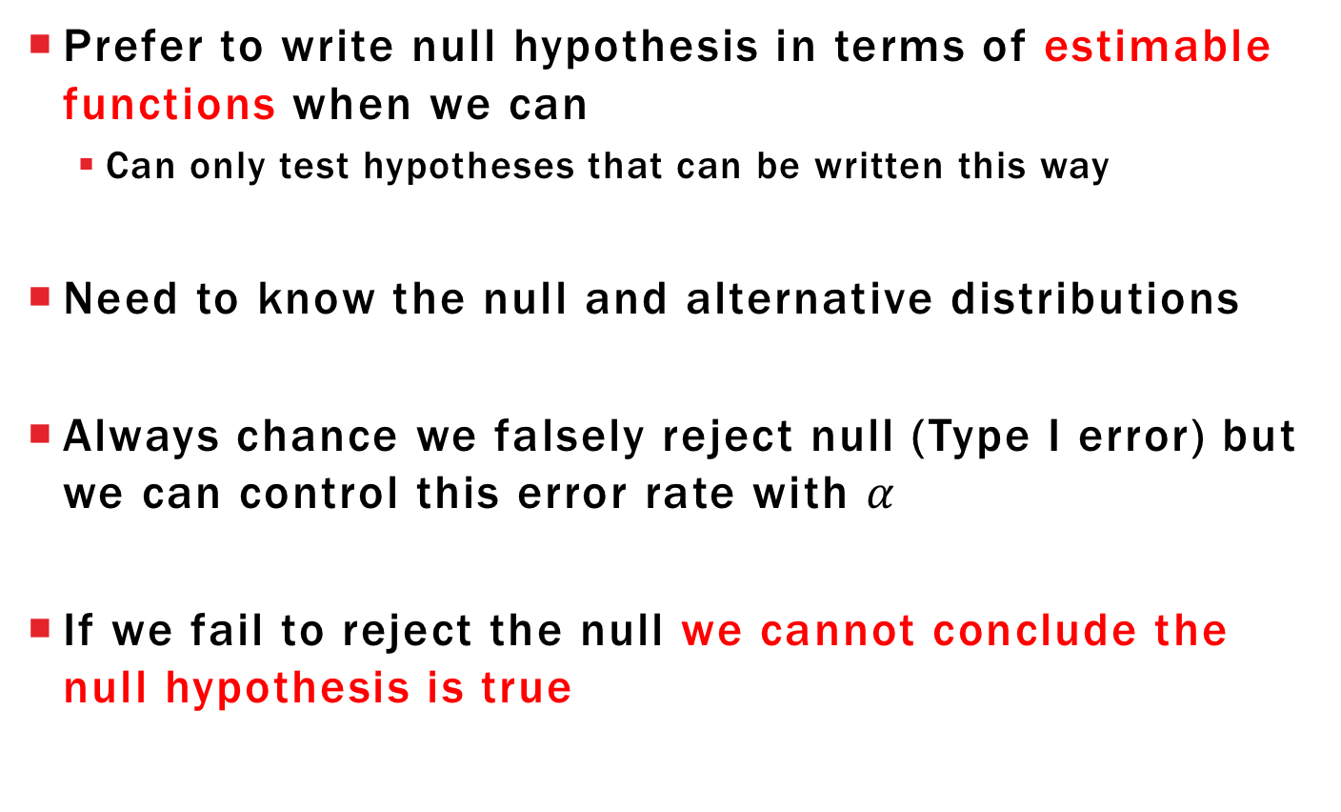
Comments about Hypothesis testing
Prefer to write null hypothesis in terms of estimable functions when we can
Can only test hypotheses that can be written this way
Need to know the null and alternative distributions
Always chance we falsely reject null (Type I error) but we can control this error rate with $α$
If we fail to reject the null we cannot conclude the null hypothesis is true

Slide 86
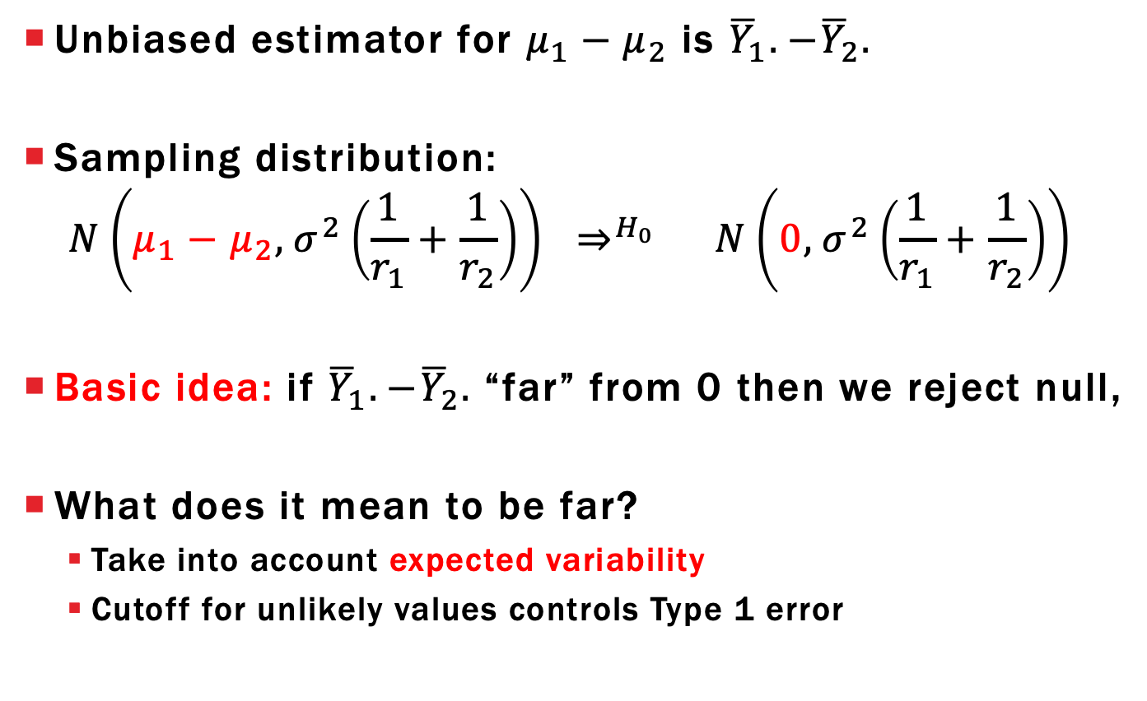
Two Sample Hypothesis testing
Unbiased estimator for $μ_{1}−μ_{2}$ is ${\overline{Y}}_{1}.−{\overline{Y}}_{2}.$
Sampling distribution:
$$N\left(μ_{1}−μ_{2}, σ^{2}\left(\frac{1}{r_{1}}+\frac{1}{r_{2}}\right)\right) ⇒^{H_{0}} N\left(0, σ^{2}\left(\frac{1}{r_{1}}+\frac{1}{r_{2}}\right)\right)$$
Basic idea: if ${\overline{Y}}_{1}.−{\overline{Y}}_{2}.$“far” from 0 then we reject null,
What does it mean to be far?
Take into account expected variability
Cutoff for unlikely values controls Type 1 error

Slide 87
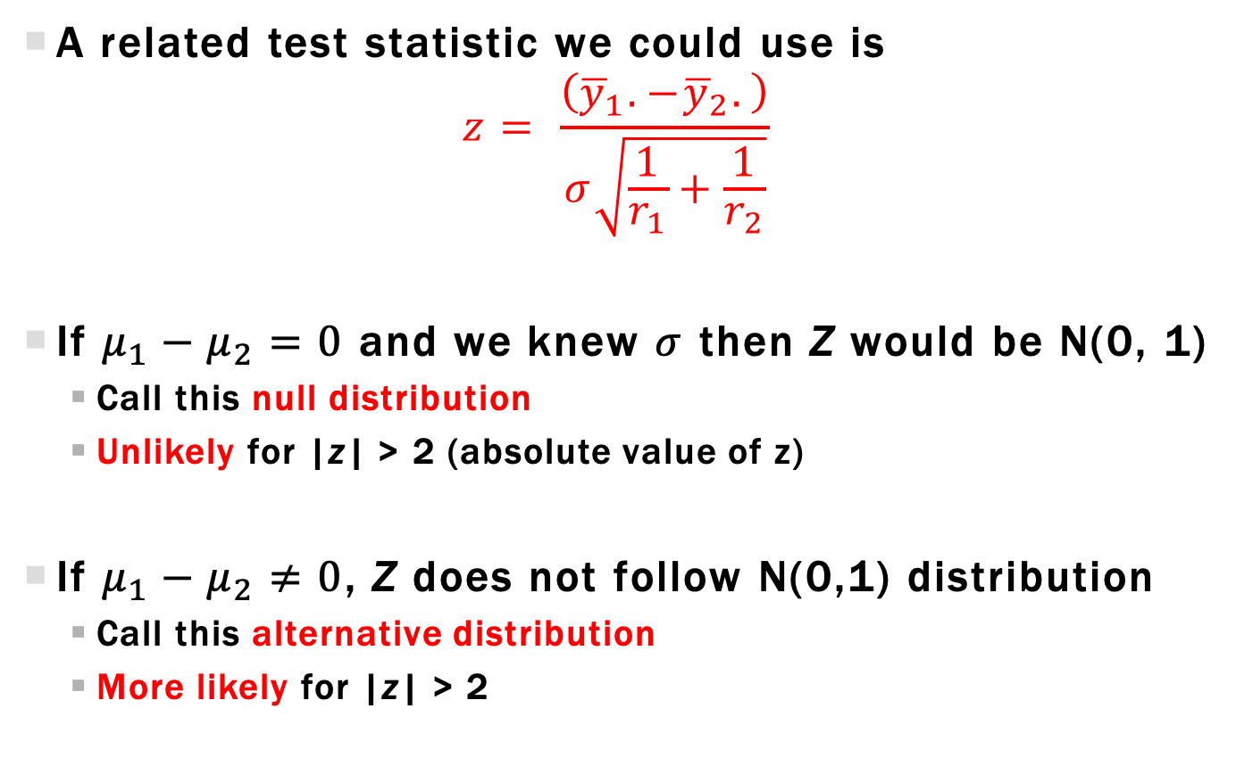
Two-sample Z-Statistic
A related test statistic we could use is
$$z= \frac{\left({\overline{y}}_{1}.−{\overline{y}}_{2}.\right)}{σ\sqrt{\frac{1}{r_{1}}+\frac{1}{r_{2}}}}$$
If $μ_{1}−μ_{2}=0$ and we knew $σ$ then Z would be N(0, 1)
Call this null distribution
Unlikely for |z| > 2 (absolute value of z)
If $μ_{1}−μ_{2}≠0$, Z does not follow N(0,1) distribution
Call this alternative distribution
More likely for |z| > 2

Slide 88
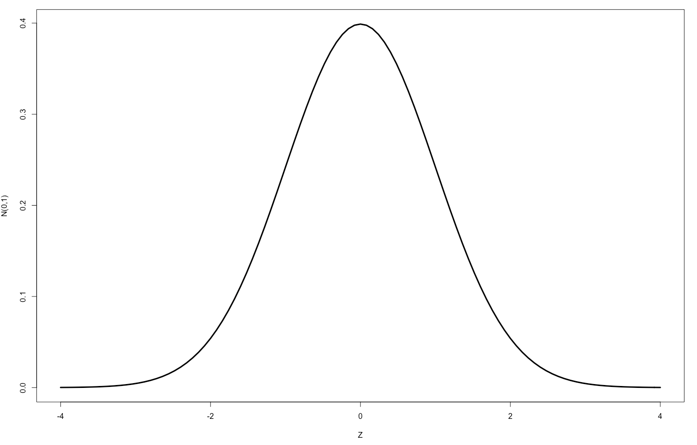
Two-sample Z-Statistic Null distribution
Plot of null distribution
If null true, then 95% chance observed Z is between -1.96 and 1.96
If observed Z is outside this range, makes sense to reject null

Slide 89
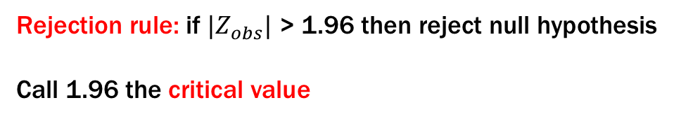
Two-Sample Z-Statistic Critical value Rejection
Plot of null distribution
Rejection rule: if ${|Z}_{obs}|$ > 1.96 then reject null hypothesis
Call 1.96 the critical value

Slide 90
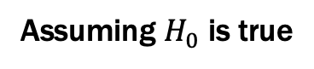
Type 1 Error
Type 1 error: reject when null is true (false reject)
$$P\left(Type 1 error\right)=P_{H_{0}}\left(\left|Z\right|>1.96\right)=0.05=α$$
Assuming $H_{0}$ is true

Slide 91
Two-Sample Z-Statistic P-value Rejection
An alternative rejection rule
Calculate probability of observed statistic (z) or more extreme value
assuming the null is true

Slide 92
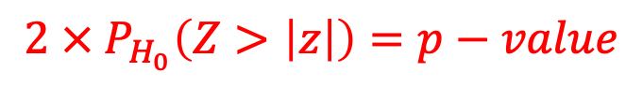
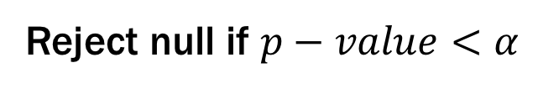
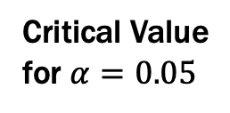
Two-Sample Z-Statistic P-value Rejection
An alternative rejection rule
|z|
Critical Value
for $α=0.05$
$$2 × P_{H_{0}}\left(Z>\left|z\right|\right)=p−value$$
Reject null if $p−value<α$

Slide 93
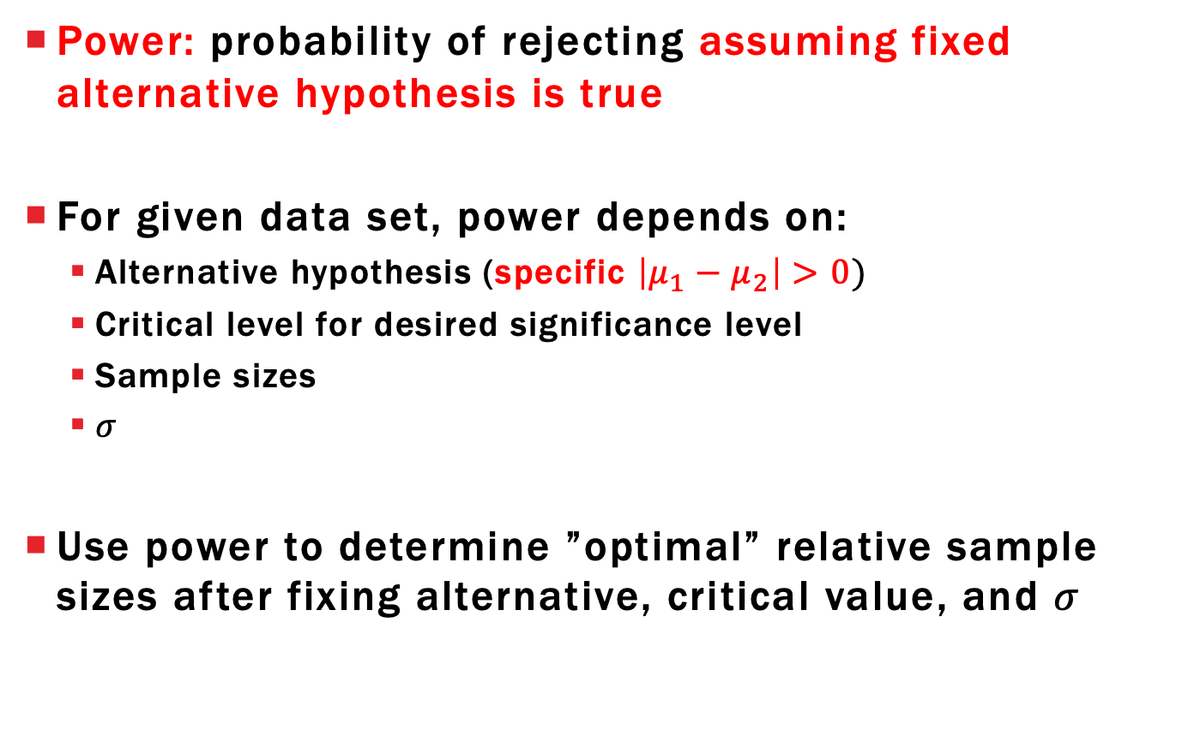
Power
Power: probability of rejecting assuming fixed alternative hypothesis is true
For given data set, power depends on:
Alternative hypothesis (specific $\left|μ_{1}−μ_{2}\right|>0)$
Critical level for desired significance level
Sample sizes
$σ$
Use power to determine ”optimal” relative sample sizes after fixing alternative, critical value, and $σ$

Slide 94
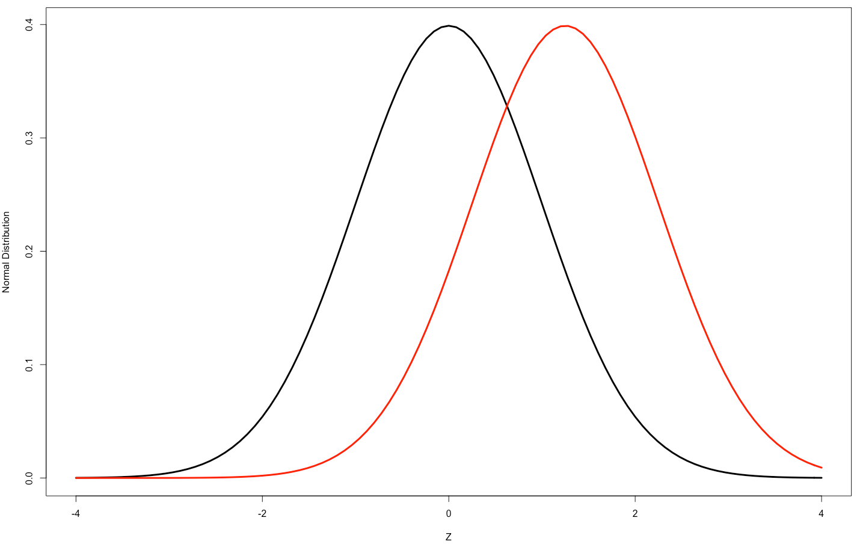
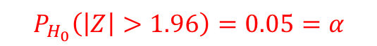
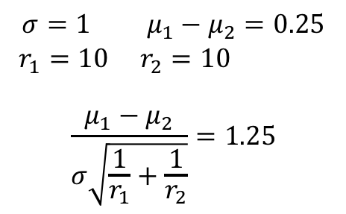
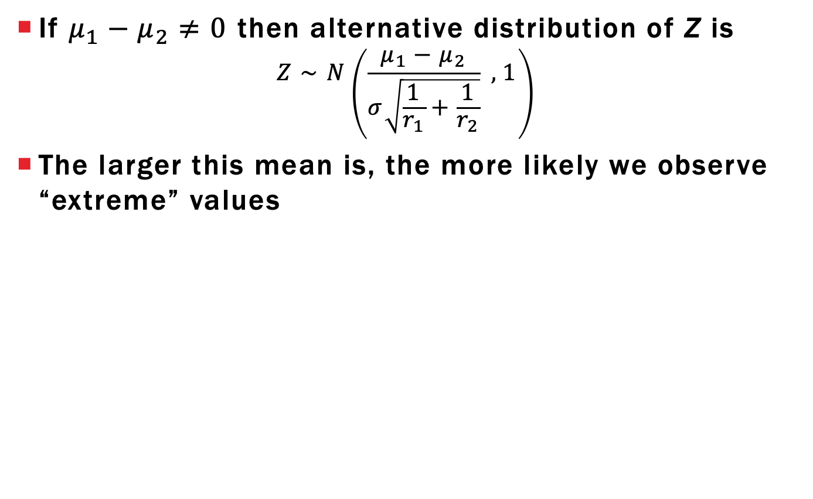
Two-Sample Z-Statistic Power
If $μ_{1}−μ_{2}≠0$ then alternative distribution of Z is
$$Z∼N\left(\frac{μ_{1}−μ_{2}}{σ\sqrt{\frac{1}{r_{1}}+\frac{1}{r_{2}}}} ,1\right)$$
The larger this mean is, the more likely we observe “extreme” values
Noncentrality
parameter
$$P_{H_{0}}\left(\left|Z\right|>1.96\right)=0.05=α$$
$$σ=1 μ_{1}−μ_{2}=0.25$$
$r_{1}=10 r_{2}=10$
$$\frac{μ_{1}−μ_{2}}{σ\sqrt{\frac{1}{r_{1}}+\frac{1}{r_{2}}}}=1.25$$

Slide 95
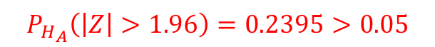
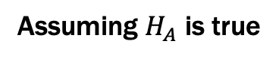
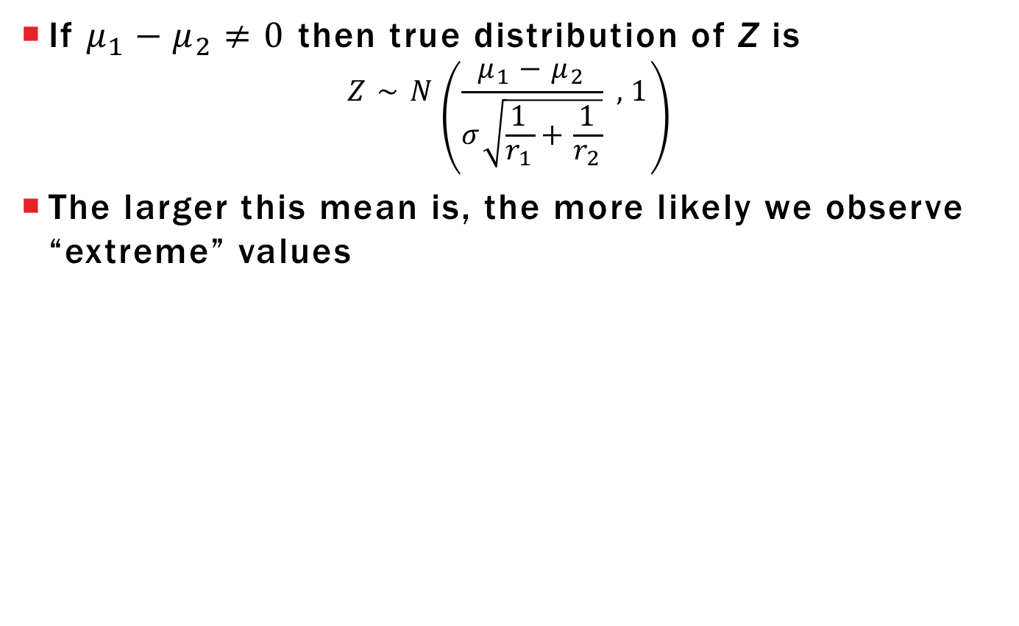
Two-Sample Z-Statistic Power
If $μ_{1}−μ_{2}≠0$ then true distribution of Z is
$$Z∼N\left(\frac{μ_{1}−μ_{2}}{σ\sqrt{\frac{1}{r_{1}}+\frac{1}{r_{2}}}} ,1\right)$$
The larger this mean is, the more likely we observe “extreme” values
$$P_{H_{A}}\left(\left|Z\right|>1.96\right)=0.2395>0.05$$
Assuming $H_{A}$ is true
$$σ=1 μ_{1}−μ_{2}=0.25$$
$r_{1}=10 r_{2}=10$
$$\frac{μ_{1}−μ_{2}}{σ\sqrt{\frac{1}{r_{1}}+\frac{1}{r_{2}}}}=1.25$$

Slide 96
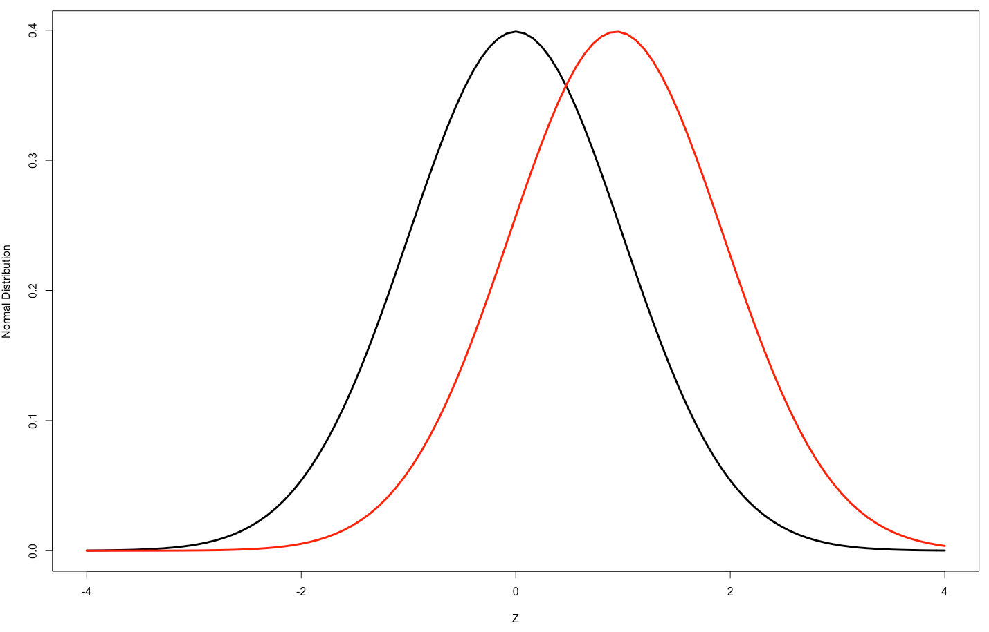
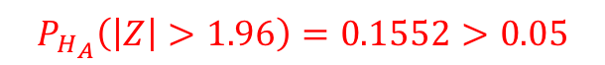
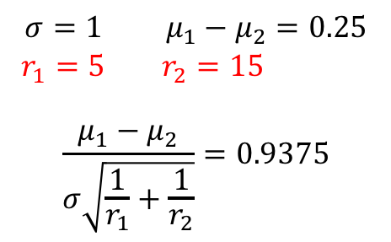
Two-Sample Z-Statistic Power
If $μ_{1}−μ_{2}≠0$ then true distribution of Z is
$$Z∼N\left(\frac{μ_{1}−μ_{2}}{σ\sqrt{\frac{1}{r_{1}}+\frac{1}{r_{2}}}} ,1\right)$$
The larger this mean is, the more likely we observe “extreme” values
$$P_{H_{A}}\left(\left|Z\right|>1.96\right)=0.1552>0.05$$
$$σ=1 μ_{1}−μ_{2}=0.25$$
$r_{1}=5 { r}_{2}=15$
$$\frac{μ_{1}−μ_{2}}{σ\sqrt{\frac{1}{r_{1}}+\frac{1}{r_{2}}}}=0.9375$$

Slide 97
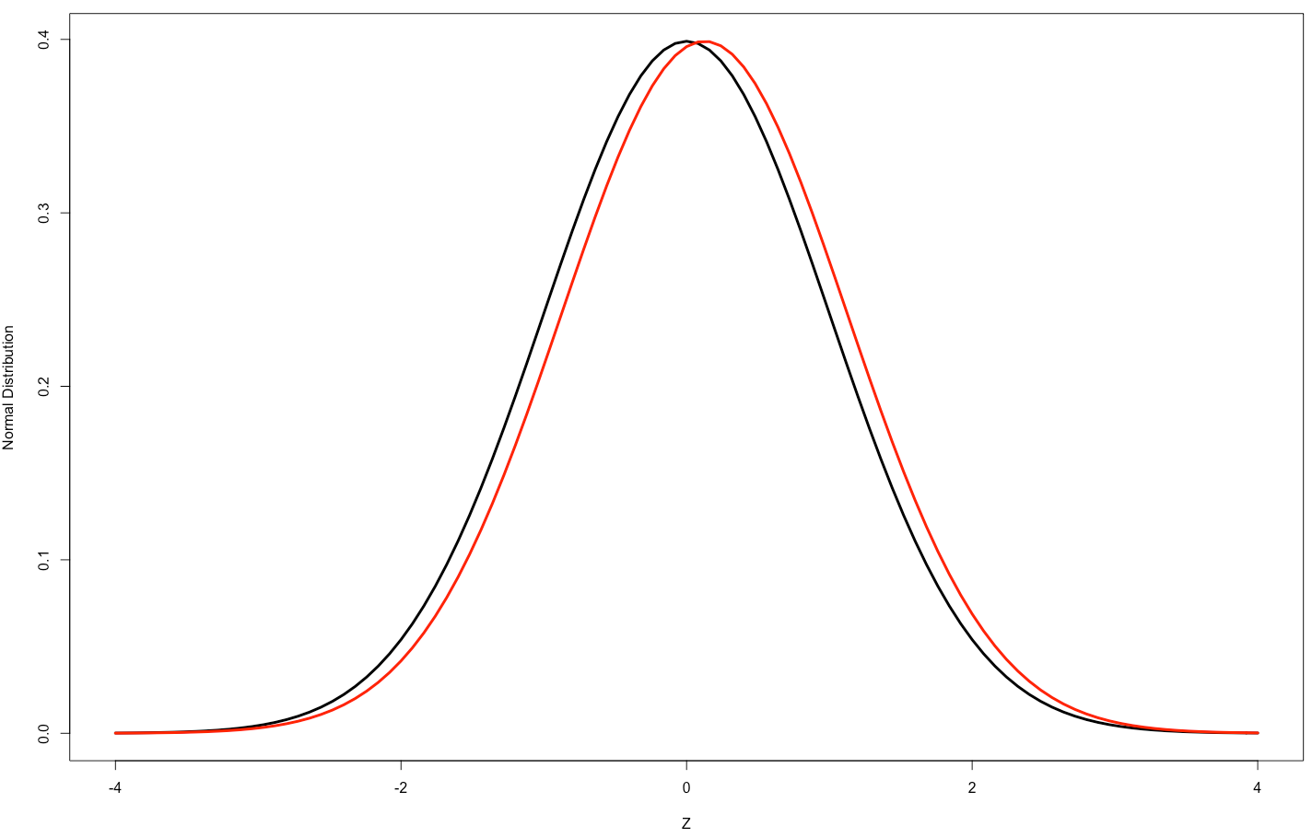
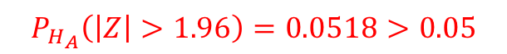
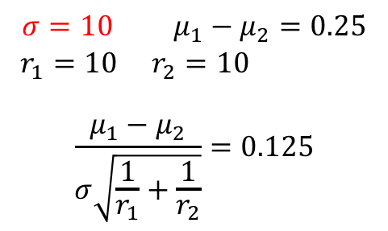
Two-Sample Z-Statistic Power
If $μ_{1}−μ_{2}≠0$ then true distribution of Z is
$$Z∼N\left(\frac{μ_{1}−μ_{2}}{σ\sqrt{\frac{1}{r_{1}}+\frac{1}{r_{2}}}} ,1\right)$$
The larger this mean is, the more likely we observe “extreme” values
$$P_{H_{A}}\left(\left|Z\right|>1.96\right)=0.0518>0.05$$
$$σ=10 μ_{1}−μ_{2}=0.25$$
$r_{1}=10 r_{2}=10$
$$\frac{μ_{1}−μ_{2}}{σ\sqrt{\frac{1}{r_{1}}+\frac{1}{r_{2}}}}=0.125$$

Slide 98
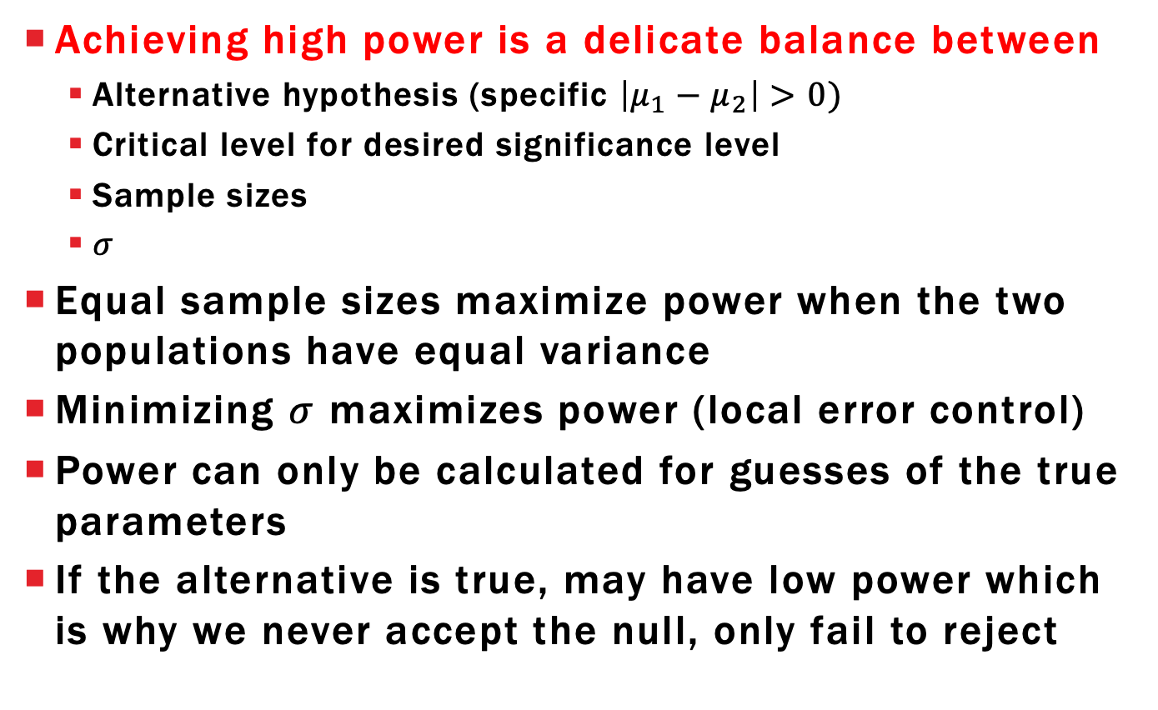
Lessons from Power
Achieving high power is a delicate balance between
Alternative hypothesis (specific $\left|μ_{1}−μ_{2}\right|>0)$
Critical level for desired significance level
Sample sizes
$σ$
Equal sample sizes maximize power when the two populations have equal variance
Minimizing $σ$ maximizes power (local error control)
Power can only be calculated for guesses of the true parameters
If the alternative is true, may have low power which is why we never accept the null, only fail to reject

Slide 99
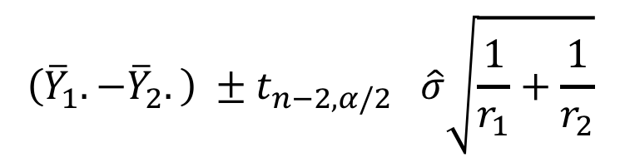
Two-Sample Confidence Intervals
If we reject the null we should provide estimate of what the difference truly is
Use a % confidence interval centered at estimate
Like “inverting” hypothesis test
$$\left({\overline{Y}}_{1}.−{\overline{Y}}_{2}.\right) ±t_{n−2,α/2} \hat{σ}\sqrt{\frac{1}{r_{1}}+\frac{1}{r_{2}}}$$
Estimator
Critical value from
T-distribution with df
Standard error of
estimate

Slide 100
Learning objectives Review
Define a sampling distribution for a statistic
Write null and alternative hypotheses for two-sample tests and simple linear regression
Understand relationship between null and alternative distributions
Explain how to calculate Type 1 error and power

Slide 101
One-Factor Analysis: part 3
ST431
Fall 2021
Chapter 3-5, 8

Slide 102
Learning objectives
Explain F-test for ANOVA using expected values of msT and msE
Explain difference between central and non-central F
Explain connection between F and T-statistic

Slide 103
Bread yeast and time to rise
Compare three different rise times to see if there is a significant difference in dough height
35, 40, and 45 minutes (quantitative or categorical?)
Large batch of dough partitioned into N loaf pans of equal size
Determine if any difference between treatment means
If there is a difference, which are different?

Slide 104
Test statistics
For t=2 used two-sample t-test
With t > 2? Multiple two-sample tests?
t=3 there would be 3 such tests
t=4, we’d have 6
t=5.... 20
t=10…45
Multiple hypothesis testing dramatically increases Type I error rate if we aren’t careful
Each test has its own Type 1 error rate
Goal: one test statistic that takes on certain values when the null is true and others when null is false

Slide 105
Testing for treatment differences Null Hypothesis
Write this as a testable hypothesis in terms of our model parameters and construct test statistics
Must involve estimable functions!
Cell Means

Slide 106
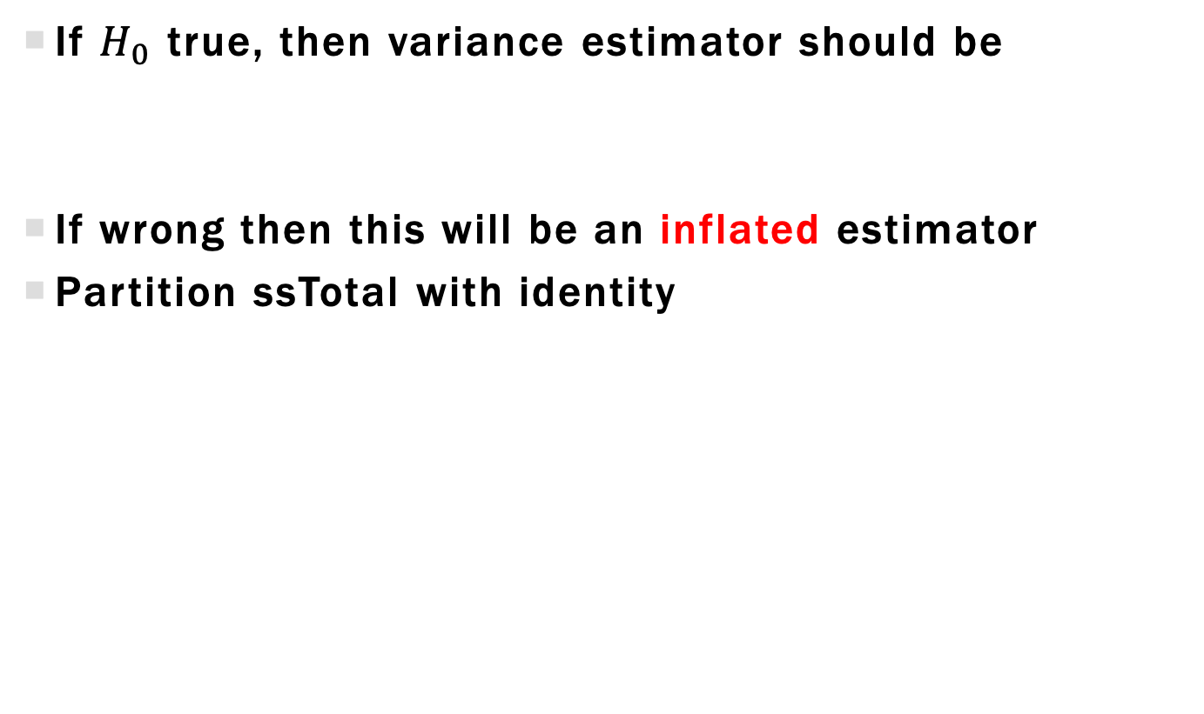
Partitioning Sources of Variance
If $H_{0}$ true, then variance estimator should be
If wrong then this will be an inflated estimator
Partition ssTotal with identity
Source of inflation!

Slide 107
Analysis of Variance SSE and SST
Look at expected values
Comments about
Equals 0 under null hypothesis
Use these statistics to create our test statistic

Slide 108
Analysis of Variance mean squares and F-statistic
Convert ssE and ssT to mean sum-of-squares by dividing by their degrees-of-freedom (df)
If msT >> msE then we have evidence null is wrong
Compare size of msT to msE with F-statistic
Under $H_{0}$, follows central F-distribution with t-1 and N-t numerator and denominator df

Slide 109
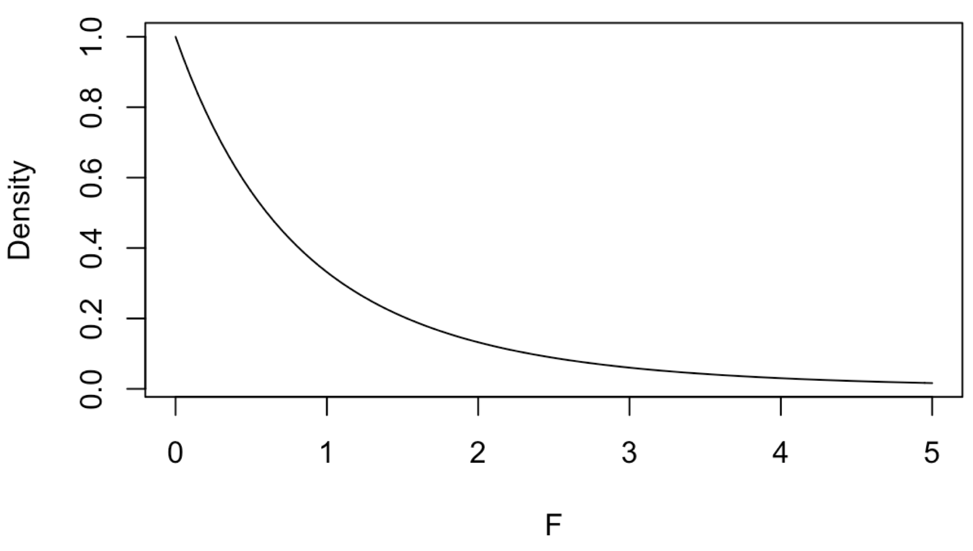
F-distribution under Null distribution
Bread example has t=3, r=4 (N=12)
F-distribution with 2 num df and 9 denom df
0.05 critical value = 4.26
P-value expression: (one-sided test)

Slide 110
Non-central F-distribution
F statistic follows central F-distribution under null
If alternative is true then it follows non-central F-distribution with noncentrality parameter
Shifts probability density to larger values, meaning larger F value are more likely
Use to calculate power and sample size
$$λ=\frac{n}{σ^{2}}\sum_{i}{\frac{r_{i}}{n}{\left(τ_{i}−\overline{τ}.\right)}^{2}=}\frac{n}{σ^{2}}δ^{2}$$

Slide 111
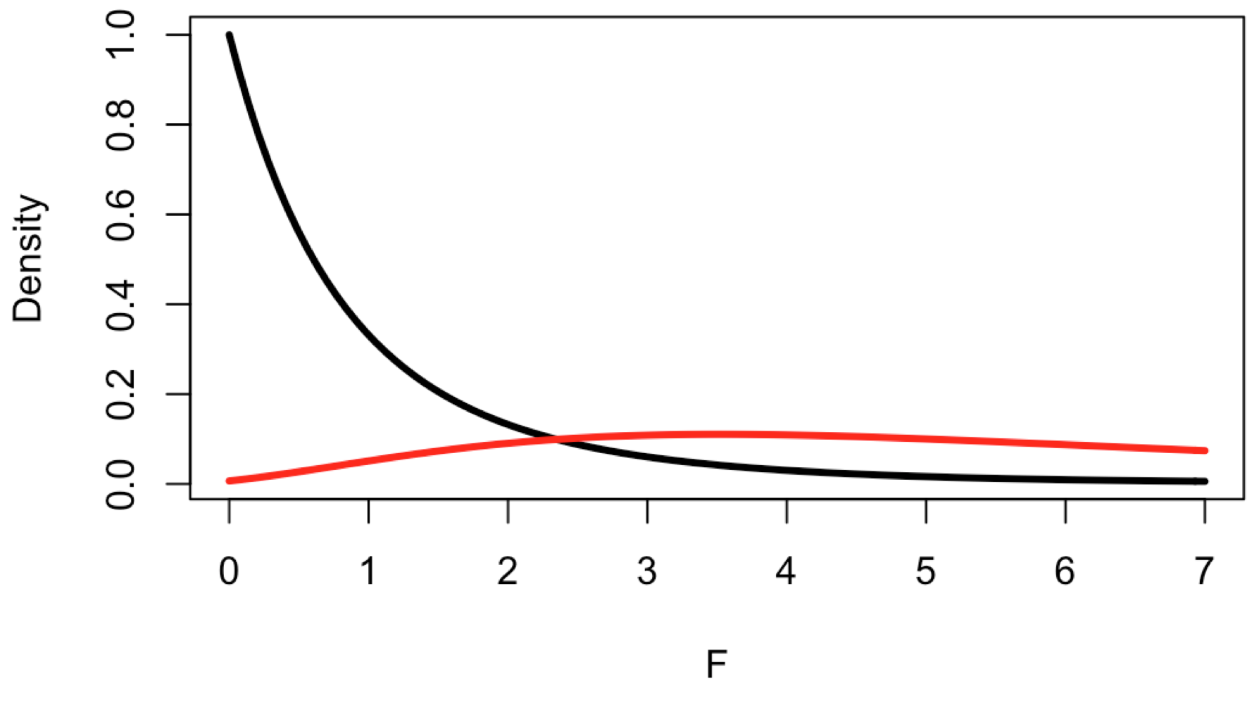
Non-central F-distribution
Bread example has 2, 9 df
Say
Critical value to reject at 0.05 level = 4.26
Noncentral F

Slide 112
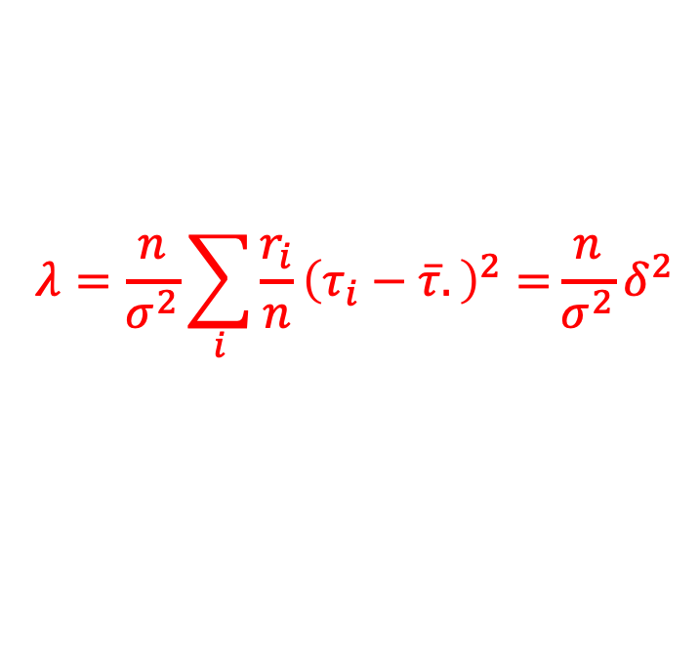
Power calculation
To calculate power, we have to specify a single alternative hypothesis through
Replicate numbers
Treatment effect parameters**
Variance
**Need to relax this unrealistic requirement
$$λ=\frac{n}{σ^{2}}\sum_{i}{\frac{r_{i}}{n}{\left(τ_{i}−\overline{τ}.\right)}^{2}=}\frac{n}{σ^{2}}δ^{2}$$

Slide 113
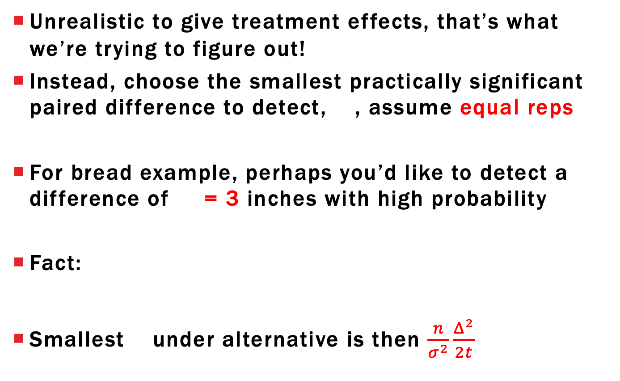
Power conservative approach
Unrealistic to give treatment effects, that’s what we’re trying to figure out!
Instead, choose the smallest practically significant paired difference to detect, , assume equal reps
For bread example, perhaps you’d like to detect a difference of = 3 inches with high probability
Fact:
Smallest under alternative is then $\frac{n}{σ^{2}}\frac{Δ^{2}}{2t}$

Slide 114
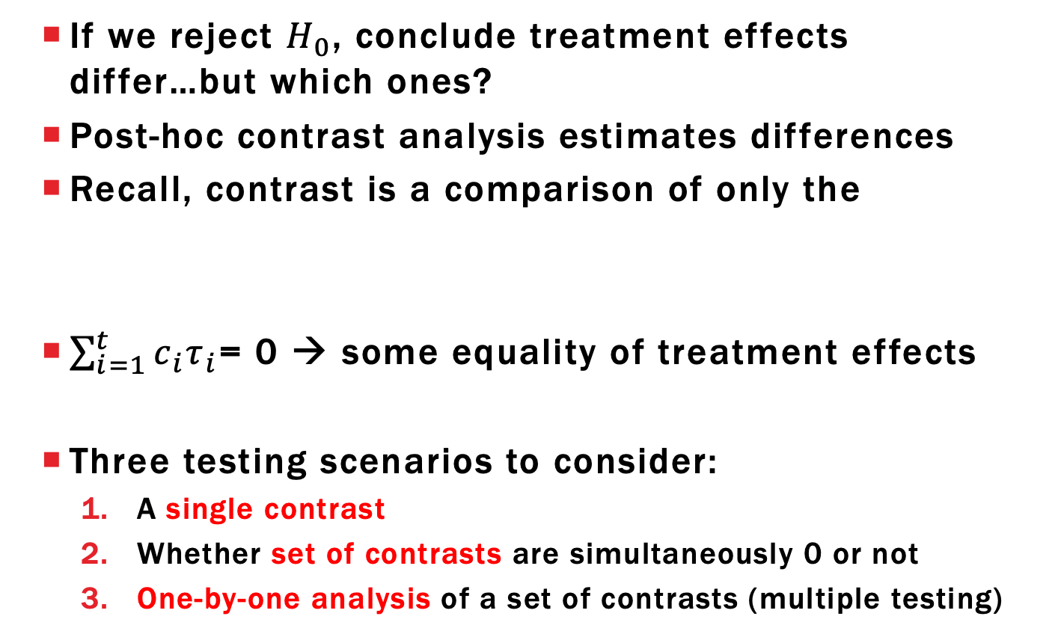
Post-Hoc Contrast Analysis
If we reject $H_{0}$, conclude treatment effects differ…but which ones?
Post-hoc contrast analysis estimates differences
Recall, contrast is a comparison of only the
$\sum_{i=1}^{t}{c_{i}τ_{i}}$= 0 → some equality of treatment effects
Three testing scenarios to consider:
A single contrast
Whether set of contrasts are simultaneously 0 or not
One-by-one analysis of a set of contrasts (multiple testing)

Slide 115
Single Contrast Sampling distribution
For the sampling distribution is
Don’t know so we use the T-statistic
Degrees-of-freedom
from MSE
Standard error

Slide 116
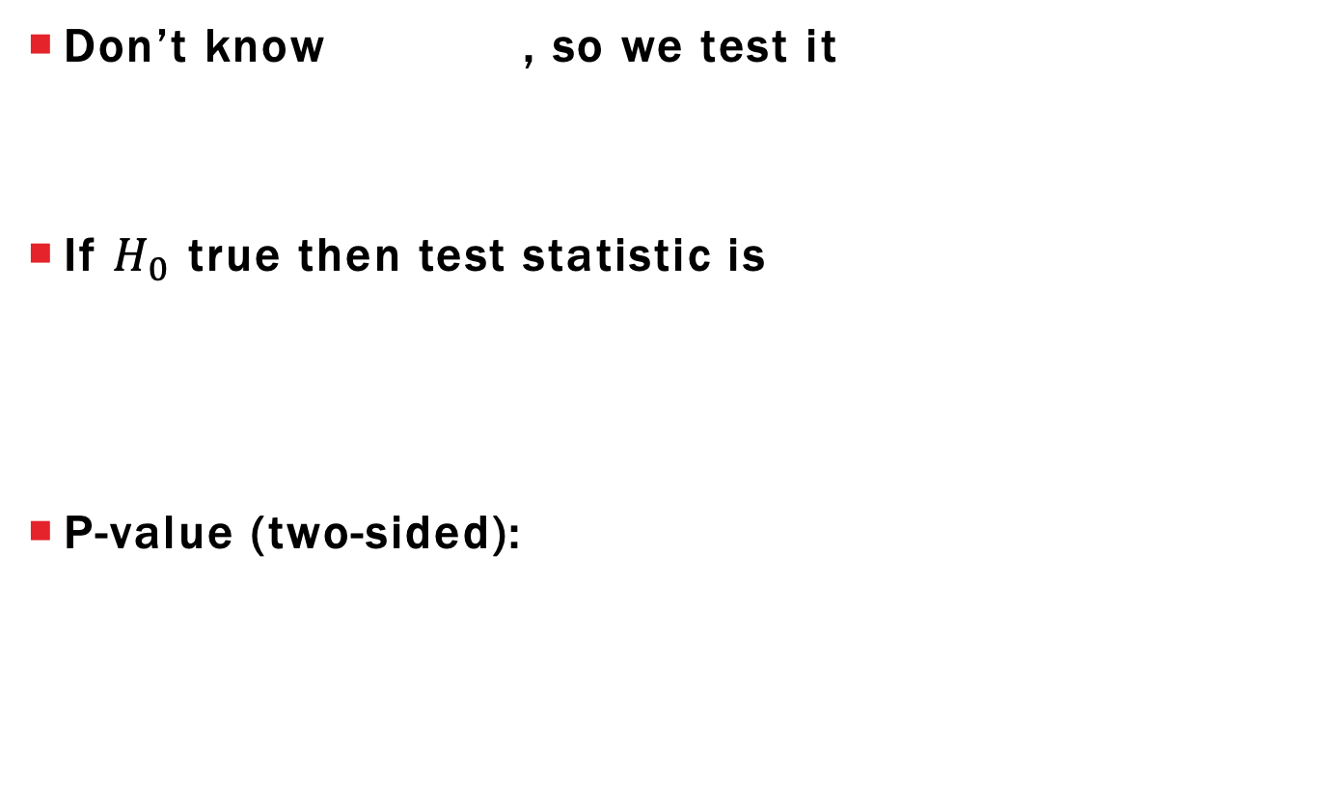
Single Contrast Hypothesis testing
Don’t know , so we test it
If $H_{0}$ true then test statistic is
P-value (two-sided):

Slide 117
Testing with Full and Reduced models
Null and alternative distributions implicitly assume all remaining contrasts are potentially nonzero
Didn’t have to think about this for two-sample problem
Referred to as full vs reduced model approach
Full model: all contrasts are significant (model DF = t-1)
Reduced model: one contrast is insignificant (model DF = t-2)
Important when simultaneously testing multiple contrasts and testing polynomial regression models
Also comes up with analysis of factorial experiments

Slide 118
Single Contrast Confidence interval
All a hypothesis tells us is what contrast isn’t
Common to use a confidence interval
Similar to the two-sample confidence interval

Slide 119
Single Contrast Sum-of-squares
Alternative test statistic for contrasts is based on the F-distribution with 1 numerator df
Under the null hypothesis
This test statistic follows central F-distribution with 1 and N-t degrees-of-freedom
Referred to as contrast sum-of-squares (SS)

Slide 120
ANOVA and contrasts
Recall the null hypothesis for ANOVA
Subtract from each part of equality and we get
Conclusion: ANOVA is simultaneously testing whether t-1 contrasts all equal 0
Full model: all possible contrasts are significant
Reduced model: no contrast significant

Slide 121
ANOVA and contrasts Linear Independence
Many equivalent expressions for null hypothesis but all of them involve t-1 linearly independent contrasts
Concept from linear algebra but we can get the gist with an example
Have three contrasts with coefficients in bread example
Write contrast coefficients as a list (or vector)

Slide 122
ANOVA and contrasts Linear Independence
The last vector can be derived from the first two
Called a linearly dependent set of contrasts
Can write one vector as a linear combination of others
Set of contrasts is linearly independent if no contrast coefficient vector can be written as a linear combination of the others
--
--
--
=
d – c = e

Slide 123
Testing Multiple contrasts
Fact 1: Largest set of linearly independent contrasts has t-1 contrasts
Fact 2: ANOVA test is equivalent to simultaneous test of t-1 linearly independent contrasts
Takeaway: We can use F-tests to simultaneously test a set of linearly independent contrasts
Works for linearly independent sets with less than t-1 contrasts as well!

Slide 124
General Linear Hypothesis Test
Have k < t-1 linearly independent contrasts and want to test whether all simultaneously equal 0
Defines the reduced model
Software generates required F-statistic and calculates p-value based on F-distribution with k and N-t degrees-of-freedom
F-statistic in general requires matrix computations but can be calculated by hand in special situations

Slide 125
One-at-a-time testing of Contrasts Multiple comparisons
Even with these general contrast hypotheses, still left without knowledge of which individual effects are truly different from 0
Naïve Approach: Confidence intervals for each
Issue: Proposed confidence level only applies to a single interval
We want to be confident that all proposed intervals simultaneously have the proposed confidence level

Slide 126
Multiple comparisons
Suppose we want k>1 confidence intervals
Then the probability of all confidence intervals capturing the true contrasts simultaneously could be as low as
Example: k=5 and would give lower bound of 0.75
Idea: make intervals larger to prevent this…
…can’t make them too large or they won’t be useful

Slide 127
Multiple comparison adjustments
Tukey’s HSD (Honestly significant difference):
Only works for paired differences
Adjusts critical value to be from studentized range distribution
Dunnett Adjustment:
Specific pairwise comparisons to reference treatment
Usually control or the “best” treatment

Slide 128
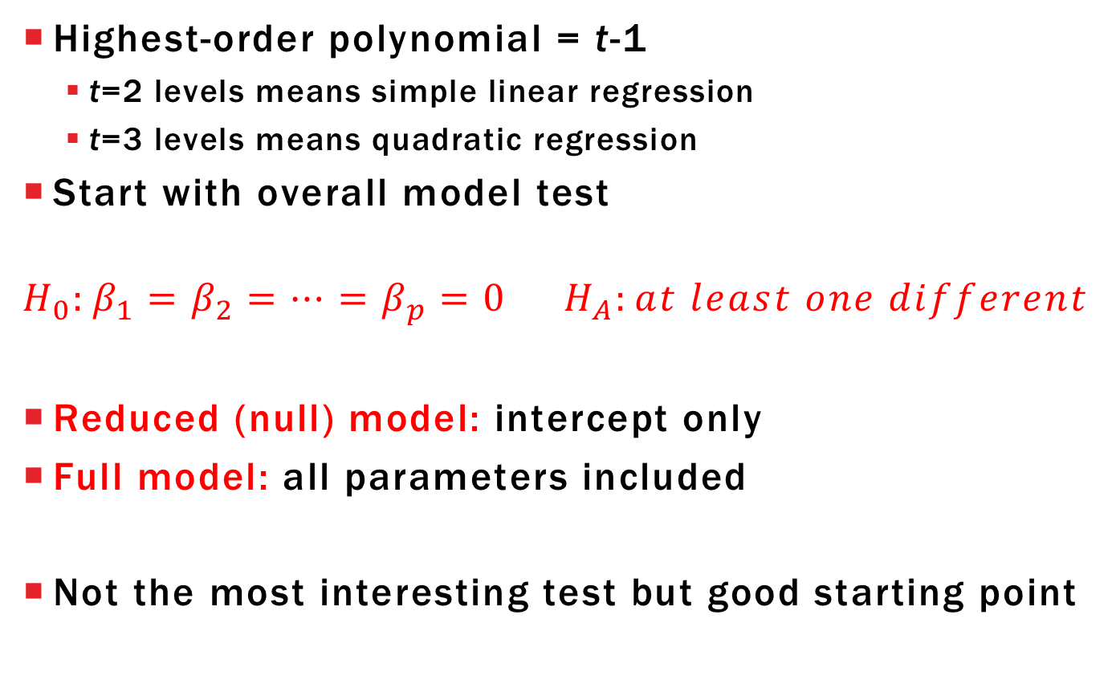
Polynomial Regression Inference: Overall Model
Highest-order polynomial = t-1
t=2 levels means simple linear regression
t=3 levels means quadratic regression
Start with overall model test
$$H_{0}:β_{1}=β_{2}=…=β_{p}=0 H_{A}:at least one different$$
Reduced (null) model: intercept only
Full model: all parameters included
Not the most interesting test but good starting point

Slide 129
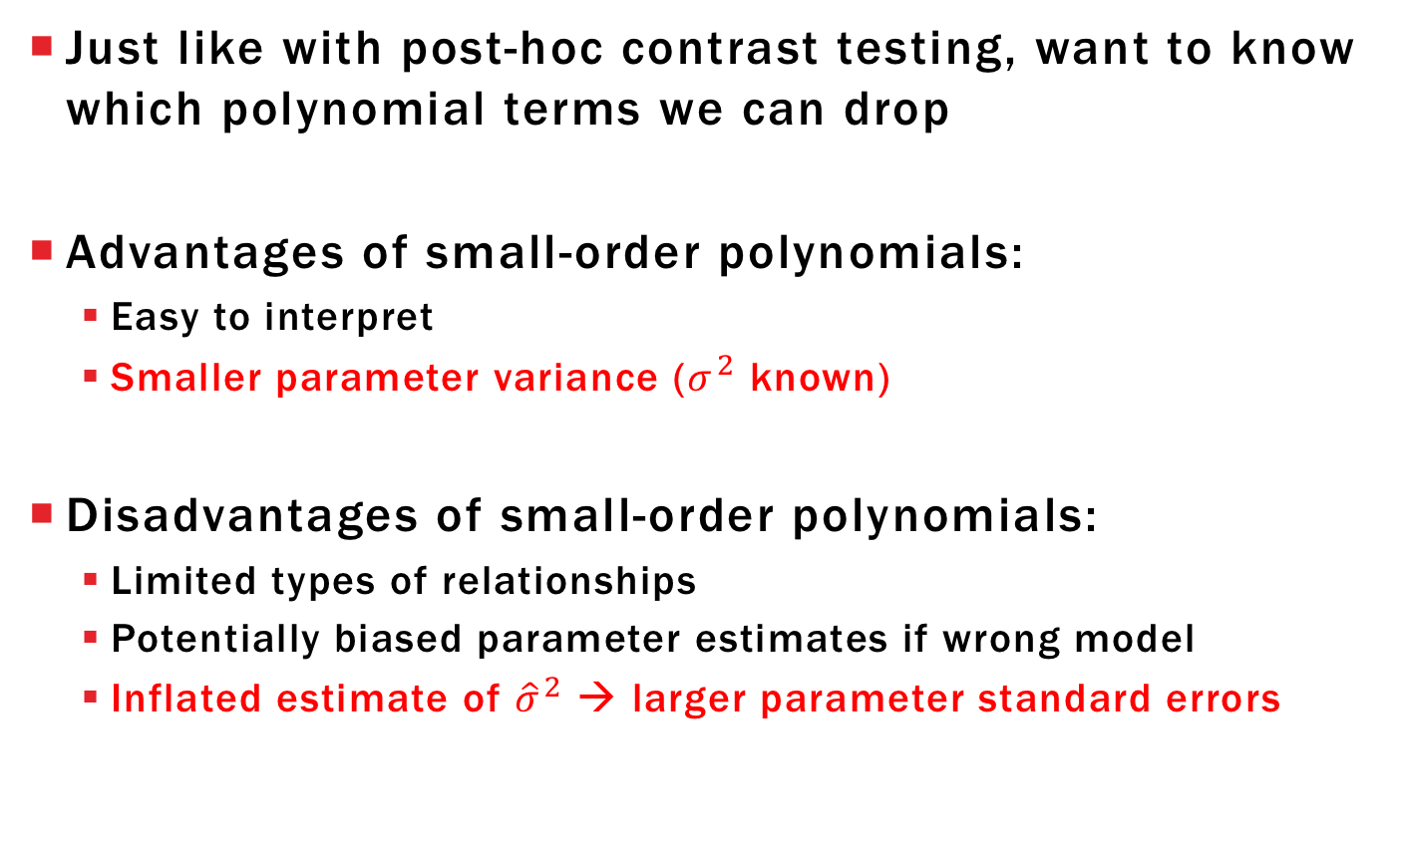
Polynomial Regression Inference: Model Selection
Just like with post-hoc contrast testing, want to know which polynomial terms we can drop
Advantages of small-order polynomials:
Easy to interpret
Smaller parameter variance ($σ^{2}$ known)
Disadvantages of small-order polynomials:
Limited types of relationships
Potentially biased parameter estimates if wrong model
Inflated estimate of ${\hat{σ}}^{2}$ → larger parameter standard errors

Slide 130
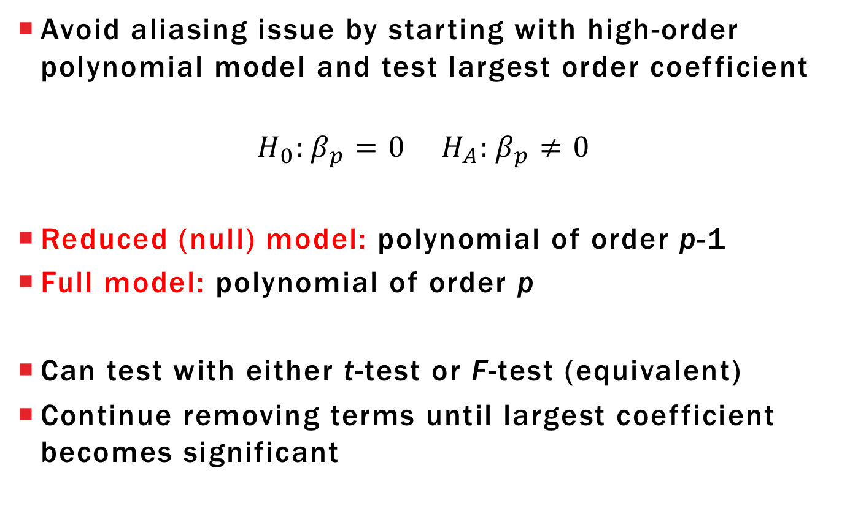
Backwards Elimination
Avoid aliasing issue by starting with high-order polynomial model and test largest order coefficient
$$H_{0}:β_{p}=0 H_{A}:β_{p}≠0$$
Reduced (null) model: polynomial of order p-1
Full model: polynomial of order p
Can test with either t-test or F-test (equivalent)
Continue removing terms until largest coefficient becomes significant

Slide 131
Learning objectives Review
Explain F-test for ANOVA using expected values of msT and msE
Explain difference between central and non-central F
Explain connection between F and T-statistic

Slide 132
COMPLETELY RANDOMIZED DESIGNS
Chapter 3

Slide 133
LEARNING OBJECTIVES
Explain what complete randomization means
Perform randomization in R (lab 7)
State assumptions that make this design appropriate
Define experimental and observational error
Give hypothetical examples for sources of variation contributing to the two types of error

Slide 134
COMPLETELY RANDOMIZED DESIGNS (CRD)
Every experimental design starts with a pre-randomized design plan
CRD plan is most basic:
List out all possible treatment levels (could come from one or more treatment factors)
Decide number of replicates per treatment level
Given CRD plan, assignment of treatments to EUs is done completely at random
Randomization is valid if it preserves the desired replication

Slide 135
BREAD RISING EXAMPLE RANDOMIZATION
Treatment factor: time to rise (3 levels)
Assign levels 1, 2, and 3 to r₁, r₂, and r₃ EUs (r₁+r₂+r₃=N)
Example: N=12 loaf pans with r₁ = r₂ = r₃ =4
Randomization procedure is valid is every permutation of treatment labels is equally likely
NOT THE SAME AS SAYING EVERY EU HAS SAME CHANCE TO BE ASSIGNED A GIVEN TREATMENT
EU | 1 | 2 | 3 | 4 | 5 | 6 | 7 | 8 | 9 | 10 | 11 | 12
Trt | 1 | 1 | 1 | 1 | 2 | 2 | 2 | 2 | 3 | 3 | 3 | 3
Trt | 1 | 2 | 3 | 3 | 3 | 2 | 2 | 1 | 1 | 3 | 2 | 1
Trt | 2 | 2 | 2 | 3 | 1 | 2 | 3 | 1 | 1 | 3 | 1 | 3

Slide 136
INCORRECT RANDOMIZATION SCHEMES
Examples of the wrong way to randomize:
For each EU, randomly generate number from {1,2,3}
Start with EU 1 and randomly generate number from {1,2,3}, continue to other EUs until desired replication is met
Possible designs under (1) and (2)
Randomize Scheme | EU | 1 | 2 | 3 | 4 | 5 | 6 | 7 | 8 | 9 | 10 | 11 | 12
1 | Trt | 1 | 2 | 2 | 1 | 1 | 3 | 3 | 3 | 2 | 2 | 1 | 1
1 | Trt | 1 | 1 | 1 | 1 | 1 | 1 | 1 | 1 | 1 | 1 | 1 | 1
2 | Trt | 1 | 2 | 3 | 3 | 2 | 1 | 1 | 2 | 3 | 3 | 2 | 1
2 | Trt | 1 | 1 | 1 | 1 | 2 | 2 | 2 | 2 | 3 | 3 | 3 | 3

Slide 137
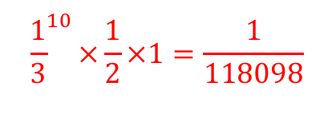
INCORRECT RANDOMIZATION SCHEMES
Scheme 2 is invalid because the two assignments have different probabilities of occurring
Randomize Scheme | EU | 1 | 2 | 3 | 4 | 5 | 6 | 7 | 8 | 9 | 10 | 11 | 12
2 | Trt | 1 | 2 | 3 | 3 | 2 | 1 | 1 | 2 | 3 | 3 | 2 | 1
Each have prob 1/3
Prob 1/2
Prob 1
Randomize Scheme | EU | 1 | 2 | 3 | 4 | 5 | 6 | 7 | 8 | 9 | 10 | 11 | 12
2 | Trt | 1 | 1 | 1 | 1 | 2 | 2 | 2 | 2 | 3 | 3 | 3 | 3

Slide 138
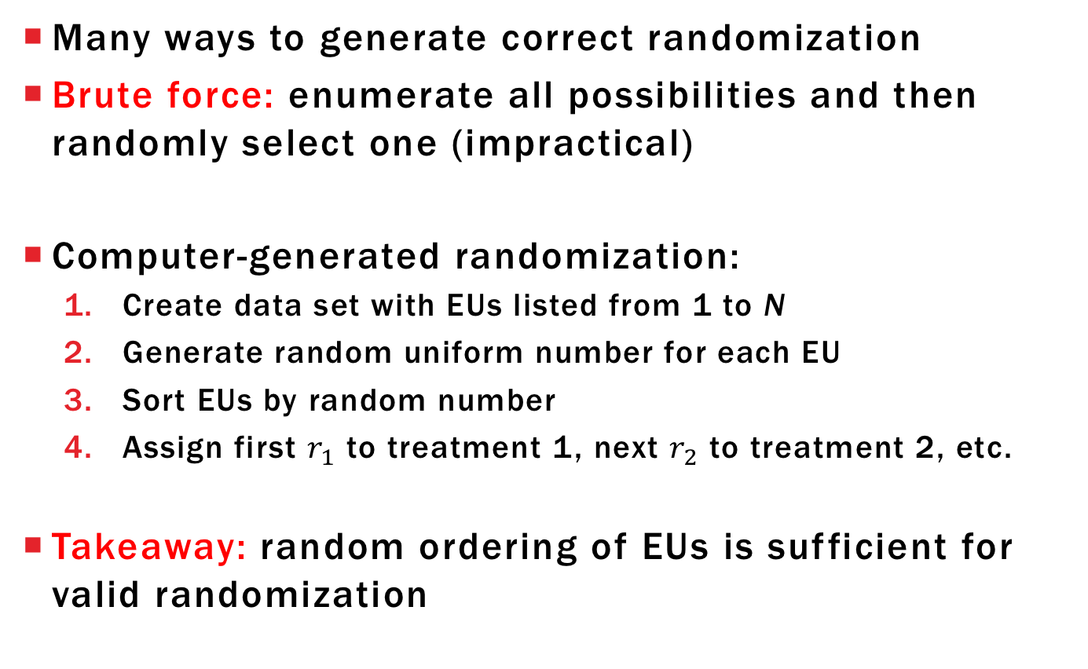
CORRECT RANDOMIZATION SCHEME

Slide 139
COMMENTS ABOUT CRDS
Treatments do not have to be equally replicated for a design to be called a CRD
Called a CRD because of randomization procedure
Recommended when EUs are fairly homogenous
Nuisance factors are either
Held constant
Measured and adjusted for with analysis of covariance

Slide 140
EXPERIMENTAL ERROR
Experimental error: variation between responses subjected to the same treatment
Sources of experimental error:
EU variability (present independently of treatment)
Treatment application error (inability to apply treatment exactly same)
EU state variability (changes in EU that occur during/after treatment separate from the treatment effect)
Environmental factors realized through state variability
Does not have OU variability = observational error

Slide 141
OBSERVATIONAL ERROR
Observational error: response variation between OUs within same EU
Sources of observational error:
OU variability (present independently of treatment)
Measurement error (inability to accurately measure a constant)
Inconsistent within-EU treatment application (inability to apply a treatment uniformly across EU)
Estimate experimental and observational variance separately only with multiple measurements per EU
Won’t consider these models right now, just average the multiple responses from same EU

Slide 142
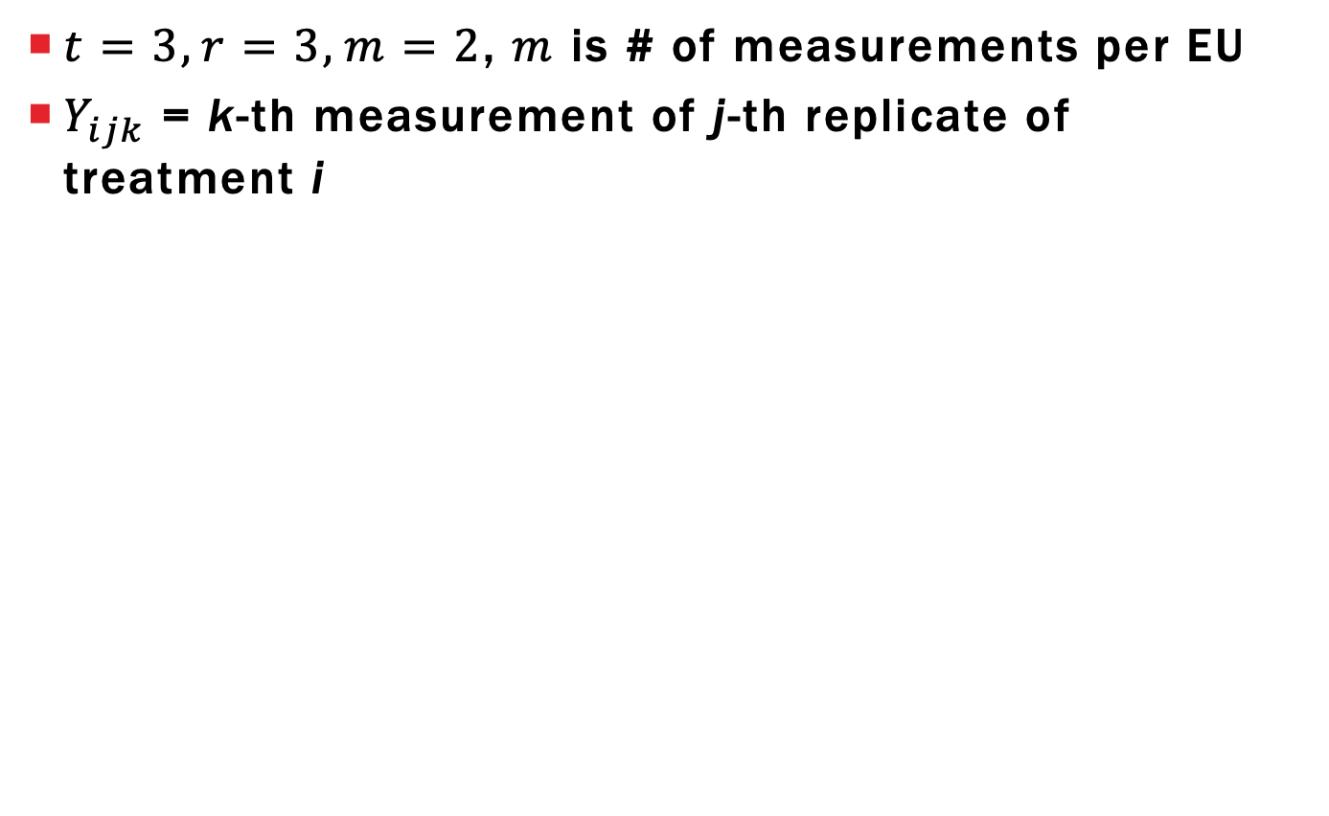
VISUALIZING OU VS EU VARIABILITY
i | 1 |  |  |  |  |  | 2 |  |  |  |  |  | 3
j | 1 |  | 2 |  | 3 |  | 1 |  | 2 |  | 3 |  | 1 |  | 2 |  | 3
k | 1 | 2 | 1 | 2 | 1 | 2 | 1 | 2 | 1 | 2 | 1 | 2 | 1 | 2 | 1 | 2 | 1 | 2
OU variability between measurements from same EU
(variability for fixed values i and j)

Slide 143
VISUALIZING OU VS EU VARIABILITY
i | 1 |  |  |  |  |  | 2 |  |  |  |  |  | 3
j | 1 |  | 2 |  | 3 |  | 1 |  | 2 |  | 3 |  | 1 |  | 2 |  | 3
k | 1 | 2 | 1 | 2 | 1 | 2 | 1 | 2 | 1 | 2 | 1 | 2 | 1 | 2 | 1 | 2 | 1 | 2
EU variability between average measurements across EU with same treatment
(variability for fixed value i)

Slide 144
FERTILIZER AND TOMATO PLANTS
Box et al (1978) describe experiment to determine whether a change in fertilizer mixture would change yield of tomato plants (# tomatoes from plant)
11 tomato plants were planted in a single row, fertilizer A or B was randomly assigned to each plant
Container | 1 | 2 | 3 | 4 | 5 | 6 | 7 | 8 | 9 | 10 | 11
Fertilizer | A | A | B | B | A | B | B | B | A | A | B

Slide 145
LEARNING OBJECTIVES
Explain what complete randomization means
Perform randomization in R (lab 7)
State assumptions that make this design appropriate
Define experimental and observational error
Give hypothetical examples for sources of variation contributing to the two types of error

Slide 146
Analysis of Covariance
Chapter 9

Slide 147
Learning objectives
Explain differences between treatment factors and covariates
Explain usual assumptions between covariates, treatments, and responses
Write ANCOVA models for a single covariate
Perform ANCOVA in R (upcoming Lab)

Slide 148
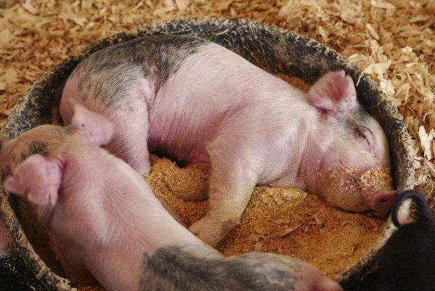
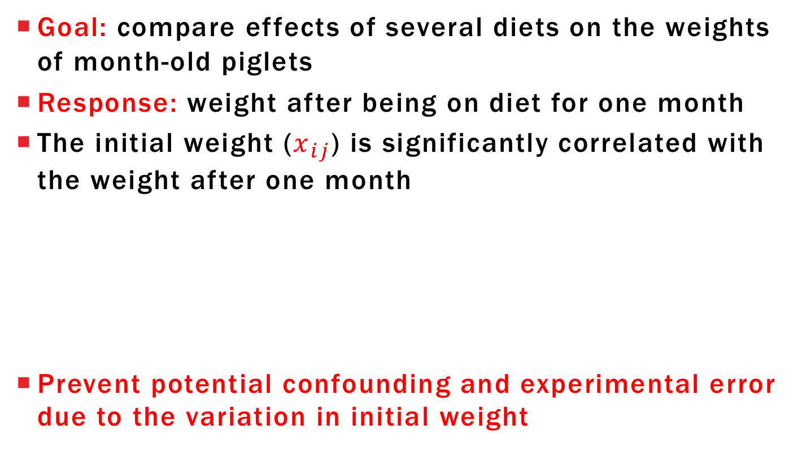
Motivating Example
Goal: compare effects of several diets on the weights of month-old piglets
Response: weight after being on diet for one month
The initial weight ($x_{ij}$) is significantly correlated with the weight after one month
Prevent potential confounding and experimental error due to the variation in initial weight

Slide 149
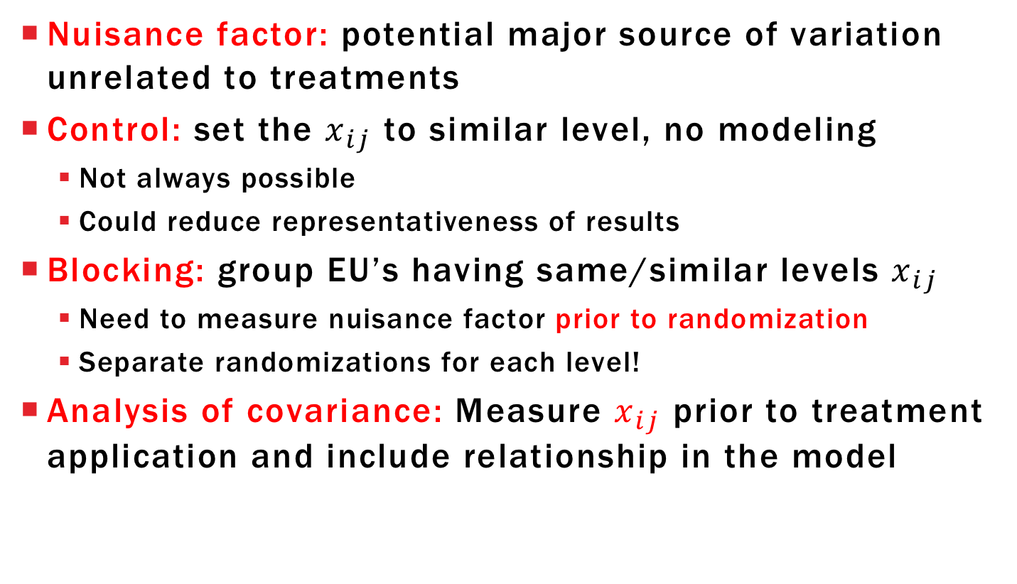
Covariates and nuisance factors
Nuisance factor: potential major source of variation unrelated to treatments
Control: set the $x_{ij}$ to similar level, no modeling
Not always possible
Could reduce representativeness of results
Blocking: group EU’s having same/similar levels $x_{ij}$
Need to measure nuisance factor prior to randomization
Separate randomizations for each level!
Analysis of covariance: Measure $x_{ij}$ prior to treatment application and include relationship in the model

Slide 150
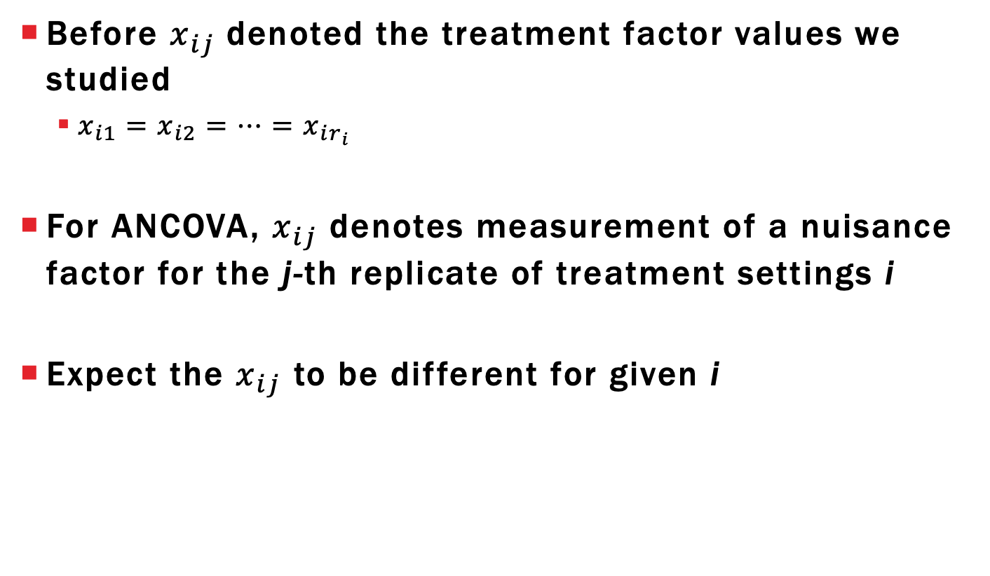
Notation Comments
Before $x_{ij}$denoted the treatment factor values we studied
$x_{i1}=x_{i2}=…=x_{ir_{i}}$
For ANCOVA, $x_{ij}$ denotes measurement of a nuisance factor for the j-th replicate of treatment settings i
Expect the $x_{ij}$ to be different for given i

Slide 151
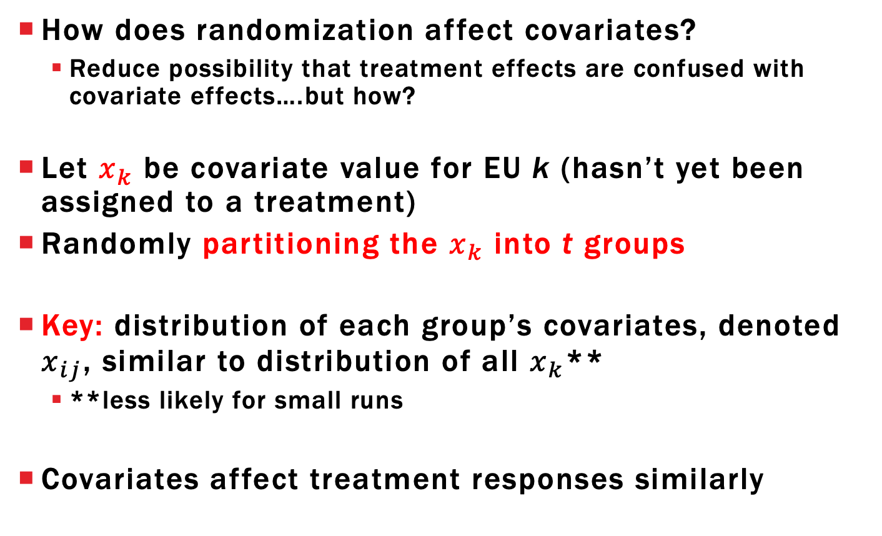
Randomization and Covariates
How does randomization affect covariates?
Reduce possibility that treatment effects are confused with covariate effects….but how?
Let $x_{k}$ be covariate value for EU k (hasn’t yet been assigned to a treatment)
Randomly partitioning the $x_{k}$ into t groups
Key: distribution of each group’s covariates, denoted $x_{ij}$, similar to distribution of all $x_{k}$**
**less likely for small runs
Covariates affect treatment responses similarly

Slide 152
ANCOVA Assumptions
Covariates explain EU/OU variation
The $x_{k}$ are not influenced by treatment
Measure covariate before treatment application
If false, then you introduce potential confounding between covariate effects and treatment effects
Won’t be able to distinguish which is important

Slide 153
Why include Covariates?
Randomization only reduces bias (potential confounding) due to covariate effect on average
msE will be inflated estimate of $σ^{2}$ if we only fit the effects model → low power
Need to include covariate effect in model
What are some common models for covariates?
Add effects to the existing models we have already seen

Slide 154
ANCOVA with Quantitative Covariates Simple Linear Regression
Assume that covariate is quantitative and relationship with response is same for all treatments
SLR ANCOVA model visualized:
Different SLR model for each treatment
Same slope parameter
Different intercepts
Comparing treatments for fixed $x_{ij}$ value gives same difference $τ_{i}−τ_{i′}$

Slide 155
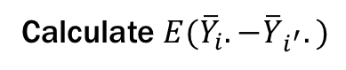
ANCOVA with Quantitative Covariates Simple Linear Regression
Write model mathematically as:
$$Y_{ij}=μ+τ_{i}+βx_{ij}+E_{ij}$$
$$μ+τ_{1}+βx_{1j}$$
$$μ+τ_{2}+βx_{2j}$$
Calculate ${E(Y}_{ij}−Y_{i^{′}j^{′}})$
Calculate ${E(\overline{Y}}_{i}.−{\overline{Y}}_{i^{′}}.)$

Slide 156
ANCOVA with Quantitative Covariates Polynomial Models
Polynomial ANCOVA model
$$Y_{ij}=μ+τ_{i}+β_{1}x_{ij}+β_{2}x_{ij}^{2}+…+β_{p}x_{ij}^{p}+E_{ij}$$
Treatment comparisons still assumed to be the same throughout the covariate values
Polynomial coefficients are estimable
Recommend backwards elimination
Lack-of-fit unlikely due to no control over $x_{ij}$ so unlikely to have replicates

Slide 157
Covariate-Treatment interaction
May find that the relationship between covariate and response changes with treatment
If treatment had no effect on the covariate value, then we need to assign a unique slope to each treatment
Treatment comparisons depend on covariate value

Slide 158
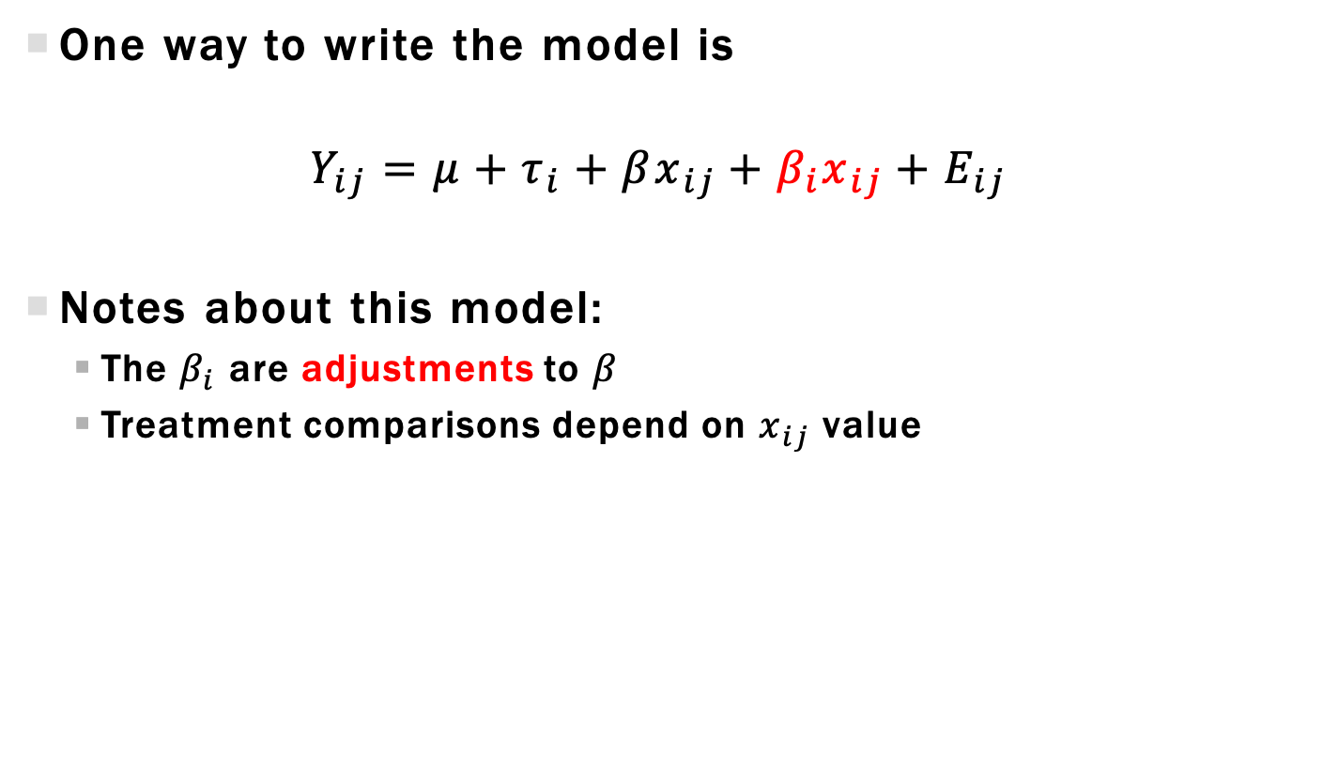
Model including Covariate-Treatment interaction
One way to write the model is
$$Y_{ij}=μ+τ_{i}+βx_{ij}+β_{i}x_{ij}+E_{ij}$$
Notes about this model:
The $β_{i}$ are adjustments to $β$
Treatment comparisons depend on $x_{ij}$ value

Slide 159
ANCOVA with Categorical Covariates
Suppose we don’t have piglet initial weight values but rather have 3 initial weight groups
Small (1), Medium (2), Large (3)
Distribution of categories:
How many small/medium/large assigned to each treatment group?
Random assignment means we EXPECT equal distribution
For a given experiment, the distribution will not be equal
Small | Medium | Large
11 | 9 | 10

Slide 160
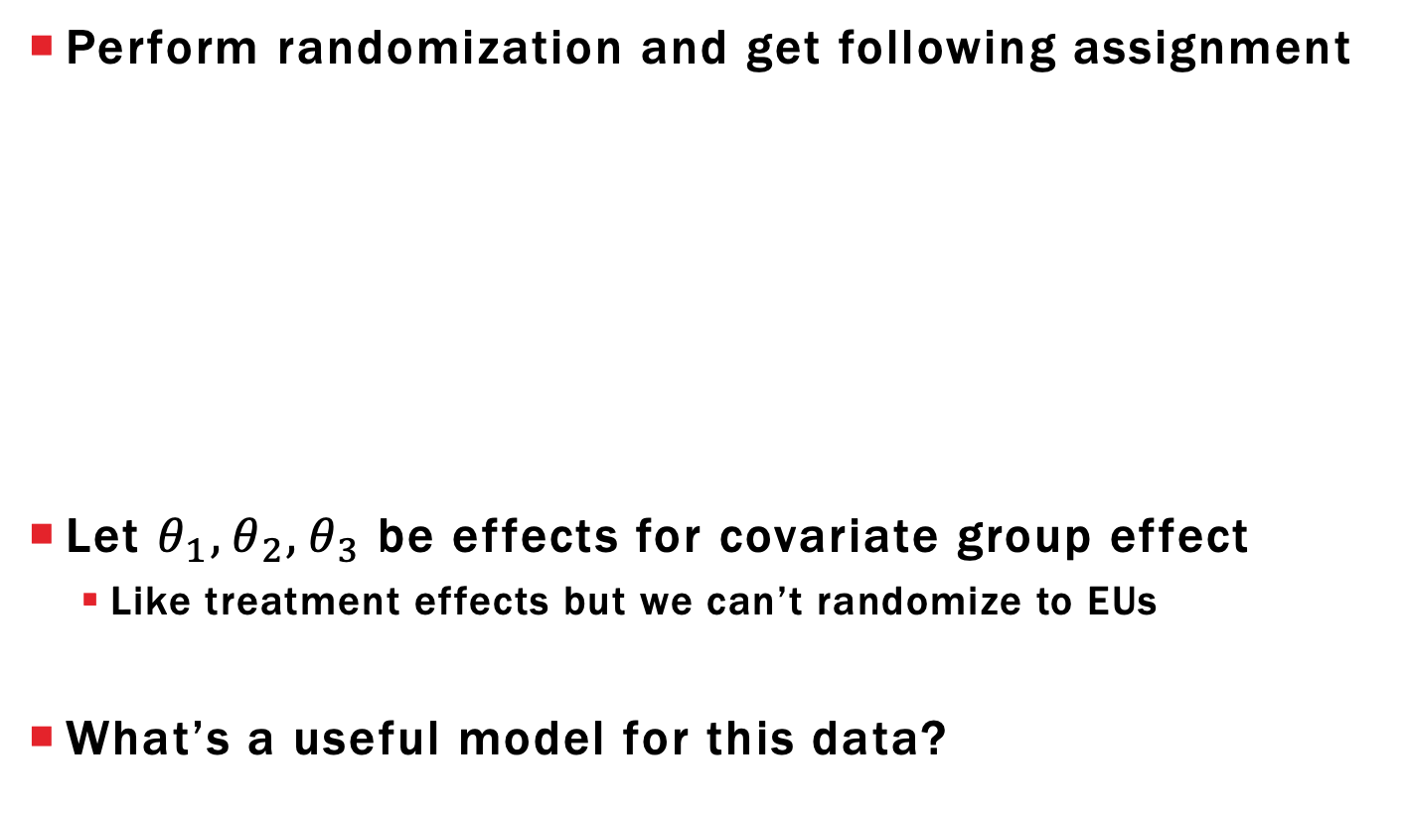
ANCOVA with Categorical Covariates
Perform randomization and get following assignment
Let $θ_{1}, θ_{2},θ_{3}$ be effects for covariate group effect
Like treatment effects but we can’t randomize to EUs
What’s a useful model for this data?
 |  | Small | Medium | Large | Total:
Treatment | 1 | 3 | 3 | 4 | 10
 | 2 | 2 | 4 | 4 | 10
 | 3 | 6 | 2 | 2 | 10
 | Total: | 11 | 9 | 10

Slide 161
Categorical Covariate Model 1: Two-Factor Main effect Model
Want to combine two models together
Treatment model: $Y_{ij}=μ+τ_{i}+E_{ij}; i=1,2,3; j=1,…,10$
Initial group model: $Y_{kl}=μ+θ_{k}+E_{kl}; k=1,2,3; j=1,…,r_{k}$
$r_{1}=11, r_{2}=9; r_{3}=10$
Index individual observations using 3 subscripts:
i = treatment assigned
j = covariate group
k = replicate for paired (i,j)
Final model:
$$Y_{ijk}=μ+τ_{i}+θ_{j}+E_{ijk}$$
$i=1,2,3; j=1,2,3; k=1,…,r_{ij}; E_{ijk}∼^{iid}N\left(0,σ^{2}\right)$
$r_{11}=3,{ r}_{12}=3, r_{13}=4,…, r_{33}=2$

Slide 162
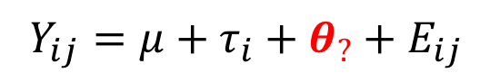

Categorical Covariate Model 2: Design-Dependent Subscripts
Keep subscripts from one-way effects model
? subscript should:
Equal 1, 2, or 3
Correspond to covariate group for jth replicate of treatment I
Let $d\left[i,j\right]∈\left\{1,2,3\right\}=$ initial group for replicate j of treatment i
The “d” means it depends on the randomized design
Final model:
$$Y_{ij}=μ+τ_{i}+θ_{?}+E_{ij}$$
$$Y_{ij}=μ+τ_{i}+θ_{d[i,j]}+E_{ij}$$
$$i=1,2,3; j=1,…,10; d\left[i,j\right]∈\left\{1,2,3\right\}; E_{ij}∼^{iid}N(0,σ^{2})$$

Slide 163
Learning objectives REVIEW
Explain differences between treatment factors and covariates
Explain usual assumptions between covariates, treatments, and responses
Write ANCOVA models for a single covariate
Perform ANCOVA in R (upcoming Lab)

Slide 164
INTRO TO FACTORIAL EXPERIMENTS
Chapter 6

Slide 165
LEARNING OBJECTIVES
Describe one factor at a time experiment and why it is a poor design for factorial experiments
Explain what a simple effect is
Explain what it means for two factors to interact and for a factor to have a main effect
Describe and draw design space for given scenario
Generate and randomize designs

Slide 166
FACTORIAL TREATMENT STRUCTURES
Focus has been one treatment factor with t levels representing different treatment applications
What makes these treatment applications different?
Maybe t levels arise from a combination of settings across multiple treatment factors
Identify the number of factors
Identify the number of levels per factor
Identify relationship between levels of factor (crossed/nested)
Say that the treatments have a factorial structure

Slide 167
PAPER HELICOPTER
Experiment looking at different paper helicopter models and their flight time
Each helicopter is manipulated by both
Body width (3.25, 3.75, 4.00, 4.25 inches)
Wing length (4.00, 4.75, 5.50, 6.00 inches)
Q: How many treatment factors are there? How many levels per factor? How many total treatment factors?
Design an experiment that allows us to understand the individual factor effects
Intuition: investigate one factor at a time
Fix the level of the other factor while we explore one of them

Slide 168
ONE FACTOR AT A TIME (OFAT) EXPERIMENTATION
Wing Length (WL) = 4 when varying Body Width (BW)
Body Width = 3.25 when varying WL
Intuitively sounds good, we are simplifying the experiment!
Are we overlooking something?
Assumes the effects when changing Body Width are consistent across levels of Wing Length

Slide 169
PAPER HELICOPTER INTERACTIONS
Potential counter-example:
WL = 4”, we see increasing flight time as BW increases
WL = 6”, there are no differences between BW
When a situation like this occurs, we say that the factor effects interact
Studying factors individually doesn’t make sense
Want to understand whether effects interact

Slide 170
PAPER HELICOPTER INTERACTION VISUALIZATION
Visualize the situation just described
Interpretation: the effect of Body Width on Flight Time depends on the level of Wing Length
WL=4”
Flight Time
WL=6”
3.25
3.75
4.00
4.25
Body Width (inches)

Slide 171
PAPER HELICOPTER SIMPLE EFFECTS
Pick BW contrast, temporarily ignoring WL
To demonstrate, focus on BW(4.25)-BW(3.25)
Question: when we estimate this contrast, what do we do about the other factor?
A BW contrast for a fixed level of WL is called a simple effect or simple contrast
Simple effects are foundation of factorial analyses

Slide 172
PAPER HELICOPTER CONTRASTS OF SIMPLE EFFECTS
Interested in consistency of simple effects as we change levels of other factors
Step 1: Declare a contrast of interest for BW BW(4.25)-BW(3.25)
Step 2: Estimate BW contrast across every WL level
4 WL levels 🡪 4 BW(4.25)-BW(3.25) simple effects
Step 3: Investigate contrasts of simple effects
Contrasts of contrasts
If simple effects are similar then these contrasts = 0
Otherwise the contrasts will be different from 0

Slide 173
PAPER HELICOPTER CONTRASTS OF SIMPLE EFFECTS
Let’s just look at 2 levels of WL
WL=4”: BW(4.25) – BW(3.25) = Large, positive #
WL=6”: BW(4.25) - BW(3.25) = 0
WL=4”
Flight Time
WL=6”
3.25
3.75
4.00
4.25
Body Width (inches)

Slide 174
PAPER HELICOPTER MAIN EFFECTS
If the simple effects are consistent across the levels of WL, then their average is a useful summary
A BW contrast’s main effect is the average of the simple effects
Main effects can always be interpreted as the average of simple effects
Main effects only meaningful in gauging a factor’s effect when simple effects are consistent

Slide 175
PAPER HELICOPTER INTERACTION EFFECTS
If simple effect estimates are inconsistent then that specific BW contrast interacts with levels of WL
Interaction contrast is a contrast of simple effects
Goal is to describe the nature of the interaction, which depends on the type of contrast you look at
Ex 1: Different for all WL levels
Ex 2: Same for levels 1,2 and levels 3,4 but different between these two groups
Ex 3: Same for levels 1, 2, and 3, but all different from 4

Slide 176
PAPER HELICOPTER MAIN AND INTERACTION EFFECTS #1
Visualize the situation just described
Every BW contrast would give same value no matter the wing length. All BW main effects meaningful!
WL=4”
Flight Time
WL=6”
3.25
3.75
4.00
4.25
Body Width (inches)

Slide 177
PAPER HELICOPTER MAIN AND INTERACTION EFFECTS #2
Visualize the situation just described
Definitely an interaction HOWEVER the one contrast of BW(4.25) – BW(3.25) is consistent!
WL=4”
Flight Time
WL=6”
3.25
3.75
4.00
4.25
Body Width (inches)

Slide 178
REVISITING OFAT DESIGN SPACES
Critique 1: OFAT captures no data that would help us determine the presence of interaction
Assumes every contrast is a main effect
Clearly seen by looking at what parts of the design space are actually performed
Design space: set of all possible treatment combination settings
Paper helicopter experiment has 4x4 = 4² = 16 treatment combinations (or design points)

Slide 179
PAPER HELICOPTER VISUALIZING DESIGN SPACE
Empty circles are coordinates that represent potential treatment settings
6.00
5.50
Wing Length (inches)
4.75
4.00
3.25
3.75
4.00
4.25
Body Width (inches)

Slide 180
PAPER HELICOPTER OFAT EXPERIMENT
An OFAT experiment (in red) does a terrible job of exploring the design space
Have no idea what
happens in this part
of the design space
6.00
5.50
Wing Length (inches)
4.75
4.00
3.25
3.75
4.00
4.25
Body Width (inches)

Slide 181
PAPER HELICOPTER FULL FACTORIAL EXPERIMENT
Factorial experiments try to fill as much as the design space as they can
Start by exploring experiments
that consider all possible settings
6.00
5.50
Already we can see that this
may lead to large, expensive
experiments
Wing Length (inches)
4.75
Need to build intuition and analysis
skills to deal with more complicated
scenarios
4.00
3.25
3.75
4.00
4.25
Body Width (inches)

Slide 182
REPLICATED FULL FACTORIAL DESIGN PLAN
Focus on two-factor experiments for now
Denote factors as A and B
Levels of A are 1, 2, …, a (similar for B)
Each treatment combination replicated at least twice
Denote replications by r_{ij}, arrange in replication table
 |  | B
 |  | 1 | 2 | … | b
A | 1 | r₁₁ | r₁₂ | … | r_{1b}
 | 2 | r₂₁ | r₂₂ | … | r_{2b}
 | … | … | … | … | …
 | a | r_{a1} | r_{a2} | … | r_{ab}

Slide 183
RANDOMIZATION AND MODEL
Factorial designs are randomized just like CRDs
Assume you have t=ab treatments
Difference comes from how you analyze the design
Later look at an analysis using cell-means and factorial effects model
Model similar to ANCOVA with a categorical covariate except you can’t control levels of covariate

Slide 184
LEARNING OBJECTIVES REVIEW
Describe one factor at a time experiment and why it is a poor design for factorial experiments
Explain what a simple effect is
Explain what it means for two factors to interact and for a factor to have a main effect
Describe and draw design space for given scenario
Generate and randomize designs

Slide 185
Randomized Complete Block Designs (RCBDs)
Chapter 10

Slide 186
Learning objectives
Identify blocking factor and explain how it is different from a treatment factor
Define a complete block design; explain how it should be randomized and perform it in R
Write statistical model for RCBD and explain where estimate of error comes from
Compare model to main effect factorial model and ANCOVA model and explain their differences
Define and calculate relative efficiency for determining impact of blocking

Slide 187
Replication and experimental error
Increasing replication only increases precision of treatment contrasts if experimental error stays same
As we increase the # of EUs in our design, more likely to observe greater experimental error…
…but the study becomes more representative
“Reduce” experimental error by identifying EU sources of variation and accounting for them in the (1) randomization procedure and (2) analysis

Slide 188
Flower Life Example
Investigate different watering techniques for extending the life of cut flowers put in a vase
Treatment factor: type of liquid put in vase
Tap water
Tap + spoonful sugar
Tap + cup of carbonated water
Tap + cup of 7-up
EUs: single flowers of comparable age
Response: Time in days until flower wilted
Group: What are some sources of variation for EUs?

Slide 189
Flower Life Example
Focus on type of flower as an important source of variation
Rose
Carnation
Daisy
Tulip
Groups: critique the following experiments
Use 16 roses and completely randomize 4 treatments (4 reps)
Use 4 of each type of flower and completely randomize 4 treatments (4 reps)

Slide 190
Block what you can; randomize what you can’t
Complete randomization of treatments to EU’s reduces impact of bias caused by EU-to-EU variability
Example: Unlikely we will confound treatments and flowers
Idea: Group EUs into homogeneous sets and perform separate CRD in each group (call a block)
A design has been blocked when:
EU’s divided into b blocks of some size (≥ 2)
Different treatments assigned to EUs in each block
Separate randomization performed in each block
ANCOVA with categorical covariates does not randomize this way

Slide 191
Blocking factors and levels
First identify EUs and their experimental conditions
Blocking factor: source of variation that potentially explains large amount of EU variation
Levels of this factor = EU groups/blocks
Choose levels so that EUs in each blocks are homogenous but different from EUs in other blocks
Different from treatment factor because we do not randomly assign these levels to the EUs
Usually an inherent characteristic of the EU or conditions the EU is put under that we do not control
Example: Flower type is a blocking factor

Slide 192
Advantages of blocking
Reduce experimental error by comparing treatments WITHIN each block, then “pool” the effects
Able to use heterogenous EUs
Increase replication without increasing experimental error
Increase representativeness of treatment effects

Slide 193
Disadvantages of blocking
Increases “complexity” of analysis (but no more than factorial experiments)
Complicated block designs more difficult to conduct, often done incorrectly
Critical you can explain how to randomize experiment
Reduces df for error more than if we had done a CRD without blocking
Hope the reduction in df is accompanied by a significant reduction in ssE

Slide 194
Terminology of Block designs
Block size = number of EU’s in a block
Dictates how many different treatments we can assign
Proper block design: each block has the same size
Complete block design with t treatments has
b blocks each of size t
Each treatment appears in each block once
Only call a group of EUs a block when we do separate randomization within each group

Slide 195
Randomization of Complete Block Design
Visualize a complete block design with t=4 treatments and b=5 blocks
Design plan shows which treatments go to which block (pre-randomization)
5 separate randomizations, one for each block
1
2
3
4
1
2
3
4
1
2
3
4
1
2
3
4
1
2
3
4
EU 1 in
Block 1
EU 4 in
Block 5

Slide 196
Randomization of Complete Block Design
Visualize a complete block design with t=4 treatments and b=5 blocks
Randomized plan might look something like this
Still have each treatment once in each block
Like 5 CRDs each with one replicate
1
4
3
2
2
4
3
1
1
3
4
2
4
1
2
3
3
1
4
2

Slide 197
Complete block design Statistical model
RCBD model is a main effect factorial model
No need for an index of replicates
Exactly like a main effect factorial model!
Perform analysis just like before*
Interaction effects are the only way to estimate error!

Slide 198
Controversy of Testing for block effects
Randomization-based models explicitly use the randomization procedure to generate model
Result: Model looks exactly like the previous slide
Problem: The usual F-ratio approach we would use to “test for block differences” is an invalid test
Ignore the p-values for testing for block, assess impact using relative efficiency
NEVER DROP BLOCK EFFECTS FROM MODEL
Those b-1 degrees of freedom can never be put back into error

Slide 199
Testing for Treatment effects
Remember, blocking is primarily considered to be a variance reduction tool
We care more about testing for treatment effects
Result: the usual F-ratio approach for testing treatment effects is still valid!
Summary of analysis of RCBD
Always includes block effects
Focus analysis on treatment effects
Post-hoc analysis only done for treatment effects

Slide 200
Relative efficiency of RCBD
Informally assess how effective blocking was by comparing MSB and MSE (look at F-value)
If MSB >> MSE then blocking was worthwhile
If MSB < MSE we reduced power…why?
Block impact assessed by the anticipated reduction in variance if we had used a CRD
Motivated by the idea of a uniformity trial which is a design with pseudo-treatments

Slide 201
Uniformity Trial
Uniformity trial: RCBD with dummy treatments would have an ANOVA table like this
Source | df | SS | MS
Block | b-1 | ssB(U) | msB(U)
Within Blocks (Error) | b(t-1) | ssE(U) | msE(U)
Total | bt-1 | ssTot(U)
Relative efficiency compares variances:

Slide 202
Estimated Relative efficiency
Rarely perform a uniformity trial, we actually apply real treatments
Use
Need estimates for ssTot(U) from our data

Slide 203
Learning objectives Review
Identify blocking factor and explain how it is different from a treatment factor
Define a complete block design; explain how it should be randomized and perform it in R
Write statistical model for RCBD and explain where estimate of error comes from
Compare the model to main effect factorial model and explain the implicit difference between them
Define and calculate relative efficiency for determining impact of blocking

Slide 204
Factorial Experiments with 2 crossed factors
Chapter 6

Slide 205
Learning objectives
Create and interpret interaction plots
Derive main effect and interaction contrasts from set of simple effects
Write main effects and interactions in terms of factorial parameters
Explain how insignificant effects are pooled into error term
Fit Model

Slide 206
Emissions Experiment
Hunter (1989) describes experiment investigating changes in CO emissions of burning fuel varying
Amount of Ethanol added (0.1, 0.2, 0.3)
Air/Fuel Ratio while burning (14, 15, 16)
Replicate each combination 2 times
Draw a picture of the design space and describe the randomization

Slide 207
Begin analysis with Plots!
Every analysis should begin with a graphical exploration of the data
Highlights unusual or missing values
Identify trends in the data that can be incorporated into the model
For factorial experiments, we are particularly interested in interaction plots

Slide 208

Interaction Plots
Interaction plot based on the ${\overline{y}}_{ij}.$
Here are ${\overline{y}}_{ij}.$ for the fuel data
Choose Ethanol as X-axis, plot 3 different lines for each level of Air/Fuel ratio
 |  | Air/Fuel Ratio (F)
 |  | 14 | 15 | 16
Ethanol (E) | 0.1 | 64 | 69.5 | 67
 | 0.2 | 79.5 | 80.5 | 67.5
 | 0.3 | 92 | 76.5 | 59

Slide 209

Interaction Plots
Hard to see any consistent behavior
Group: Interpret changes in E for each level of F

Slide 210

Analysis: one-factor effects Model
If we ignore the factorial structure of our treatments we could use the effects model
H₀: All equal each other, H_{A}: at least one different
Not an interesting hypothesis for factorial experiments
Like to investigate specific contrasts corresponding to main effects and interaction effects
$$i=1,..,a; j=1,…,b; k=1,…,r_{ij}$$
$$E_{ijk}∼^{iid}N(0,σ^{2})$$

Slide 211

Factorial Effects Model
Re-express $τ_{ij}$ that connect with the concept of main effects and interactions
Combining 2 one-way effects models + interaction
= main effect parameter applies every time level i is used
= main effect parameter applies every time level j is used
= interaction parameter that picks up what’s left of

Slide 212
Estimable functions Simple Effects
Estimable functions must be some form of a contrast
Individual parameters are not estimable without additional contraints
Simple effect contrast (say with j level fixed):

Slide 213

Factorial Effects Model Hypothesis Testing
Ideally want to test following hypotheses
$H_{0}:α_{1}=…=α_{a}$
$H_{0}:β_{1}=…=β_{b}$
$H_{0}:αβ_{11}=..=α_{ab}$
Will automatically test:
$H_{0}:α_{1}^{∗}=…=α_{a}^{∗}$
$H_{0}:β_{1}^{∗}=…=β_{b}^{∗}$
$H_{0}:αβ_{11}^{∗}=..={αβ}_{ab}^{∗}$
None of these are testable

Slide 214

Factorial Effects Model Hypothesis Testing
Reduced models don’t just drop parameters out
Easier to explain if you rewrite the model as
$μ^{∗}+α_{i}^{∗}+β_{j}^{∗}+αβ_{ij}^{∗}$ where $μ^{∗}=μ+\overline{αβ}..$
$H_{0}:α_{1}^{∗}=…=α_{a}^{∗}$ → $\left(μ^{∗}+α^{∗}\right) +β_{j}^{∗}+αβ_{ij}^{∗}$
$H_{0}:β_{1}^{∗}=…=β_{b}^{∗}$ → $\left(μ^{∗}+β^{∗}\right) +α_{i}^{∗}+αβ_{ij}^{∗}$
$H_{0}:αβ_{11}^{∗}=..=α_{ab}^{∗}$ → $\left(μ^{∗}+{αβ}^{∗}\right)+α_{i}^{∗}+β_{j}^{∗}$
Takeaway: interactions never leave the model
Reduced Model

Slide 215
Factorial Effects Model Hypothesis Testing
Each hypothesis is tested using F-statistic approach
A main effects (ssA)
B main effects (ssB)
AB interaction effects (ssAB)
A df = a-1
B df = b-1
AB df = (a-1)(b-1)
Formulas for the sum-of-squares easy for balanced data but we won’t concern ourselves with that
These df tell us how many linearly independent
contrasts we select for each group
Test on a-1 linearly independent main effects involving factor A

Slide 216
Factorial Effects Model Hypothesis Testing
Gives following ANOVA table
P-values from central F-distribution with numerator DF corresponding to their row’s DF and denominator DF equal to N-ab
Source | DF | SS | MS | F | p-value
A Main | a-1 | ssA | ssA/(a-1) | msA/msE | p_{A}
B Main | b-1 | ssB | ssB/(b-1) | msB/msE | p_{B}
AB Int | (a-1)(b-1) | ssAB | ssAB/ [(a-1)(b-1)] | msAB/msE | p_{AB}
Error | N-ab | ssE | ssE/[N-ab]
Total | N-1 | ssTot

Slide 217

pooling interactions
If we conclude the interaction contrasts are insignificant then
$$E\left(msAB\right)=σ^{2}$$
We can improve our estimate of $σ^{2}$ with
$$msE^{∗}=\frac{ssE+ssAB}{N−ab+\left(a−1\right)\left(b−1\right)}=\frac{ssE+ssAB}{N−a−b+1}$$
Model-based error estimate
Increases denominator DF which increases power when we test using $msE^{∗}$
Done using the main effect model

Slide 218

Main Effect Model
The main effect model, or the two-way ANOVA model without interactions, is
$$Y_{ijk}=μ+α_{i}+β_{j}+E_{ijk}$$
Testing for main effects same as before but with pooled error estimate

Slide 219
Learning objectives
Create and interpret interaction plots
Derive main effect and interaction contrasts from set of simple effects
Write main effects and interactions in terms of factorial parameters
Explain how insignificant effects are pooled into error term
Fit Model

